Slide 1
Data-Driven Behavioral Analytics: Observations, Representations and Models
Meng Jiang (UIUC)
Peng Cui (Tsinghua)
Jiawei Han (UIUC)
http://www.meng-jiang.com/tutorial-cikm16.html
Tutorial in CIKM 2016, October 24, Indianapolis, IN
Notes:
[University]

Slide 2
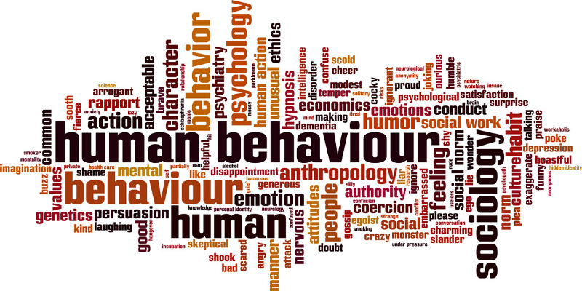
What is Behavior?
Definition. Interactions made by individuals in conjunction with themselves or their environment. (Wikipedia)

Slide 3
Behavioral Analysis
Significance. What can we discover from behavioral data?
Ex. Given every phone call/message between military leaders, scientists, businesspersons, find…
Observations
Who, what, where, when, why, how…
(scientific view)
Representations
Graph, network, matrix, tensor…
(mathematical view)
Models
Prediction, recommendation, anomaly detection… (application view)

Slide 4

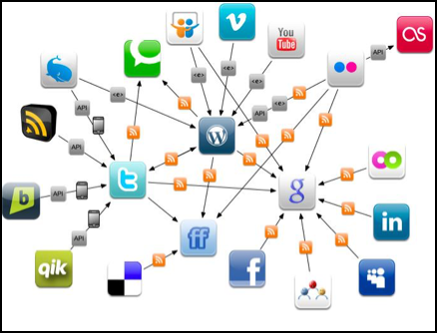
Why Behavioral Analysis Today?
Today. The human behaviors are broadly recorded in an unprecedented level. Insights of sciences and society?
Physical World
Online Applications

Slide 7
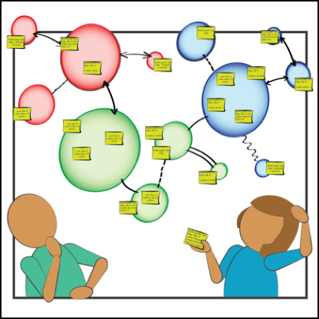
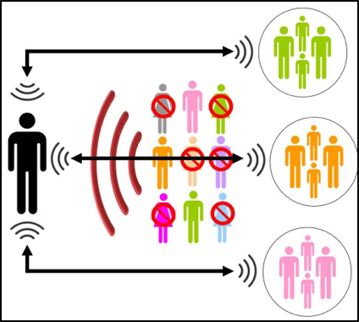
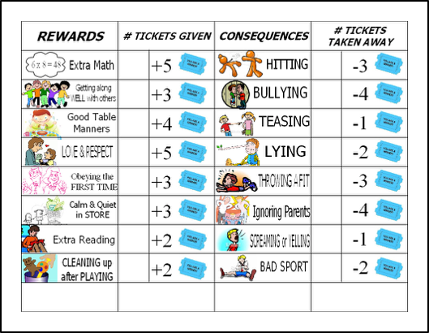
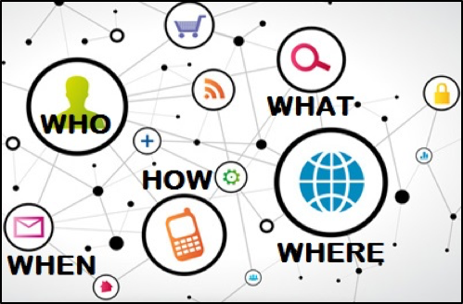
Challenges in Behavioral Analysis
Content
(preference)
Social context
(influence)
Behavioral Analysis
Spatiotemporal context
Intention
(suspiciousness)

Slide 8



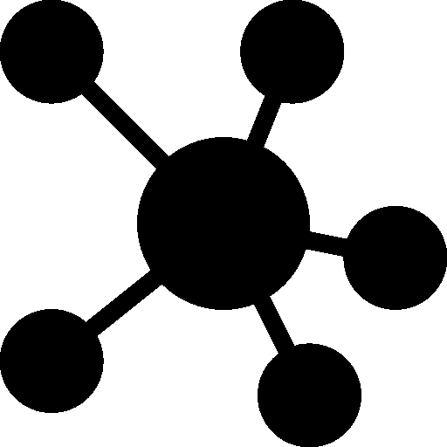



Methodology: Why Data-Driven?
Experience-Driven
Data-Driven
Applications. Recommender systems, fraud/spam detection.
Representation. Behavior Network for interaction.
Nodes: users/authors, items (e.g., products, tweets, papers), etc.
Links: (interaction) following, purchasing, tweeting, publishing, etc.
Node attributes: user profiles, item properties/features, etc.
Link attributes: similarity, distance, weight, etc.
Observation
Representation
Models/Algorithms

Slide 9




Data to Network to Knowledge
Information Network
(entities, attributes, relationships)
Structuring
Integration
Rich unstructured text data
Behavior Network
tweets, news, msgs…
u
t
product/restaurant review…
i
l
publications (abstract/full text):
PubMed, dblp, acmdl
a
Structured data
h
@

Slide 10
Outline: Data-Driven Behavioral Analytics
Mining behavior networks with social and spatiotemporal contexts to support intelligent and trustworthy systems
Mining for behavior prediction and recommendation
Mining for suspicious behavior detection
Intelligent and Trustworthy Systems
Structured Data
Behavior Networks
Behavior Prediction
& Recommendation
Summarization
Suspicious Behavior Detection

Slide 11
Outline: Data-Driven Behavioral Analytics
Mining behavior networks with social and spatiotemporal contexts to support intelligent and trustworthy systems
Mining for behavior prediction and recommendation
Mining for suspicious behavior detection
Structuring behavioral content and integrating behavioral analysis with information networks
Intelligent and Trustworthy Systems
Structured Data
Behavior Networks
Behavior Prediction
& Recommendation
+
Information Networks
Summarization
Unstructured Data
Suspicious Behavior Detection

Slide 12
I. Mining behavior networks with social and spatiotemporal contexts
I.1. Behavior prediction and recommendation

Slide 13
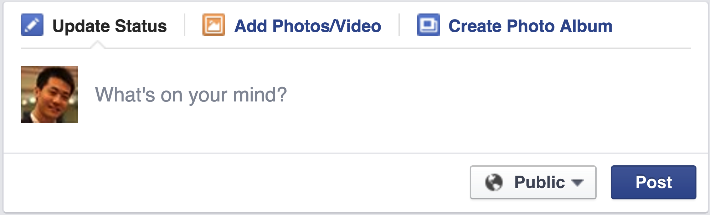
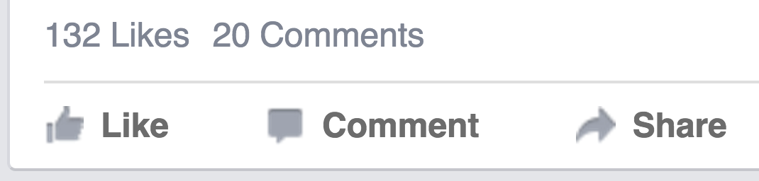



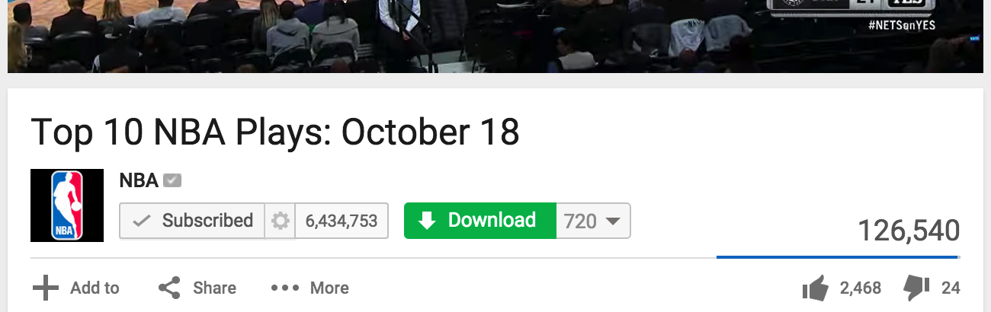
Behavior in Social Networks
Facebook: Post, Like, Comment, Share
Twitter: Post, Reply, Retweet, Favorite
YouTube: Upload, Subscribe, Download, Share, Comment

Slide 14

Behavior in Social Networks
Like
Reply
Share
Favorite
Retweet
Comment
Subscribe
Download
Add to
Send
Pin it
Visit
……

Slide 15




Social Recommender Systems
YouTube
Twitter
Pinterest
Facebook

Slide 16
Social Recommender Systems
April 20, 2011: Tencent Weibo visited Tsinghua University
Low conversion rate (< 6%): #retweets per feed request
Can we build a social recommender system?
Given
Predict which tweet/item a user will retweet.
Content similarity
(topic level) [Blei et al.]
User-item behavior network
User-user social network
i
sender
u
i
0.1
send
u
u
i
u
i
0.9
0.7
receive
u
i
receiver
i
u
i
u

Slide 17
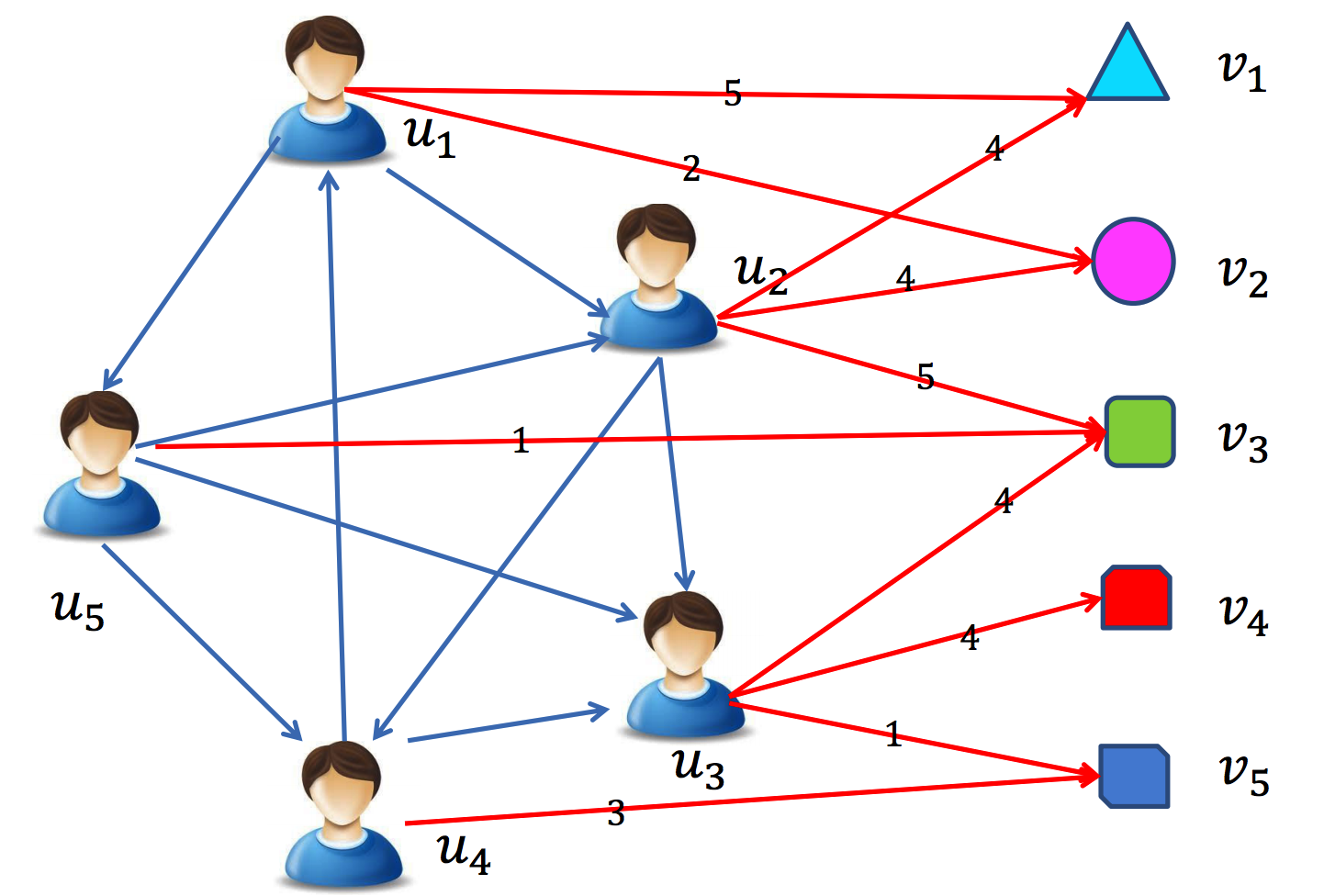
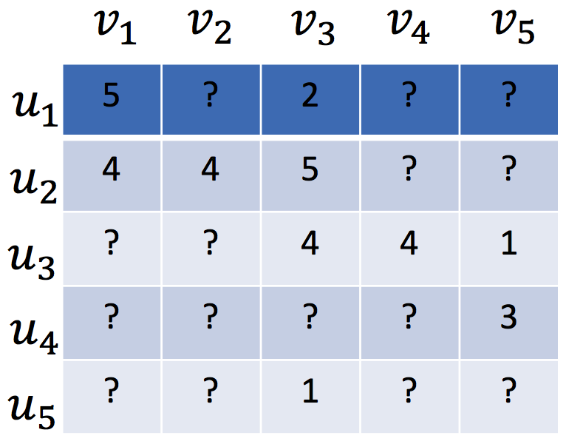
Traditional Recommender Systems
Assumed that users are independent and identically distributed (user-movie, user-book, etc.)
Notes:
Sparse user-item matrix.

Slide 18
Traditional Recommender Systems
Content-based recommender (e.g., TF-IDF)
For textual information (e.g., news, documents)
Limitation: limited content analysis, over-specialization
Collaborative filtering based recommender
Memory-based CF (e.g., PCC, similarity)
Model-based CF (e.g., factorization based)
Limitation: data sparsity, cold-start problem
Hybrid recommender system
Tang et al. Social Recommendation: A Review. Social Network Analysis and Mining, 2013. Springer.
Notes:
Second, CF. What is cold-start?

Slide 19
Matrix Factorization (MF) based CF
Low-rank MF on the user-item rating matrix R
User preference vector U
Item characteristic vector V
R
U
V^{T}
Koren. Factorizatoin Meets the Neighborhood: A Multifaceted Collaborative Filtering Model. KDD, 2008.
Notes:
Dr. Yehuda Koren. Matrix factorization. Latent factors.

Slide 20
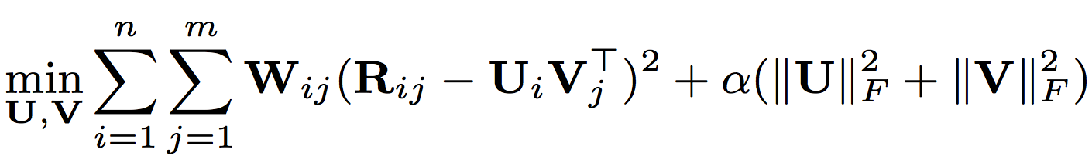
Matrix Factorization (MF) based CF
Low-rank MF on the user-item rating matrix R
User preference vector U
Item characteristic vector V
Observed weight matrix W
avoid over-fitting,
controlled by the parameter
Notes:
Observed indicators. Regularization to avoid over-fitting.

Slide 21
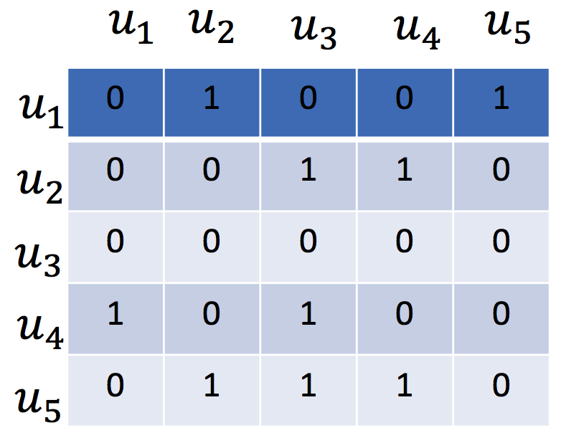
Social Recommendation
Social relations
Notes:
One more matrix input.

Slide 22
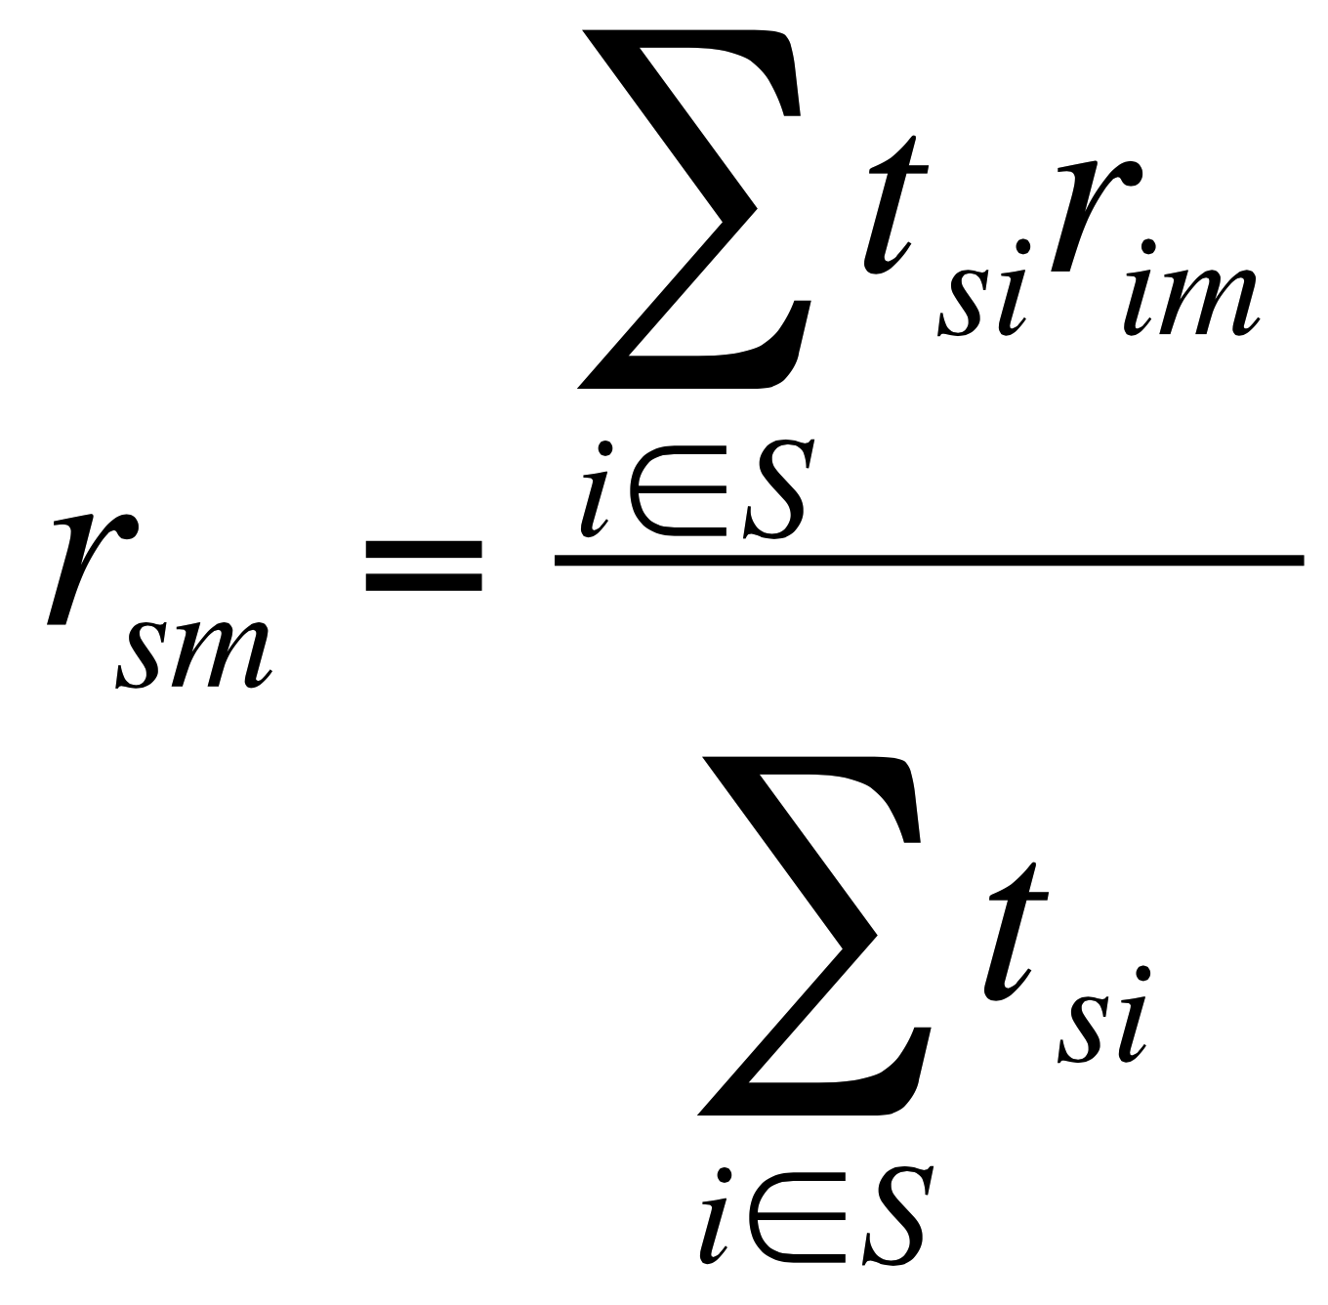
Memory based Social Recommender
TidalTrust
rating
(user i, item m)
rating
(user s, item m)
trust from social relation
(user s, user i)
Golbeck. Personalizing applications through integration of inferred trust values in semantic web-based social networks. Semantic Network Analysis Workshop, 2005.
Notes:
Average score of friends’ ratings on the same item.

Slide 23
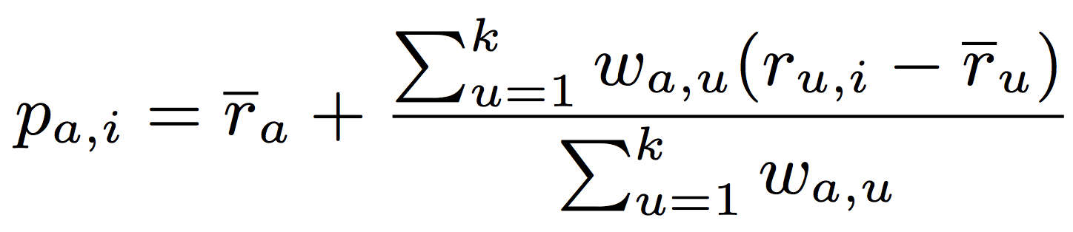
Memory based Social Recommender
MoleTrust
rating
(user u, item i)
average rating
(user u)
average rating
(user a)
predicted rating
(user a, item i)
trust from social relation
(user a, user u)
Massa et al. Trust-aware recommender systems. RecSys, 2007.
Notes:
Your preference bias on a given item. Your rating to the given item is over or below your average rating.

Slide 24
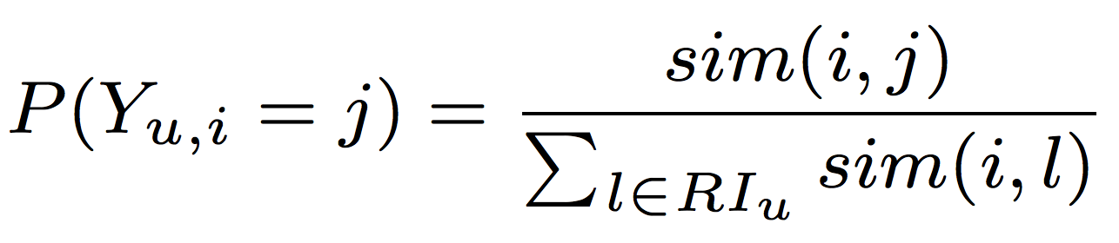
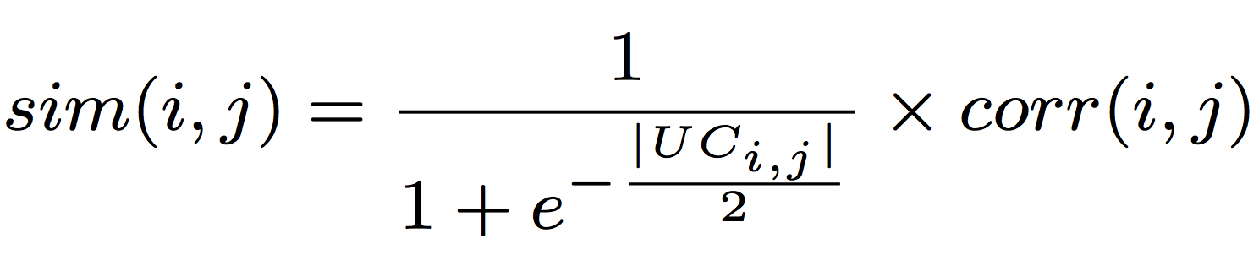
Memory based Social Recommender
similarity measure
(item i, item j)
TrustWalker
probability of
user u’s random walk
from item i to item j
Pearson correlation
of (item i, item j)
common user set
of (item i, item j)
Jamali et al. TrustWalker: A Random Walk Model for Combining Trust-based and Item-based Recommendation. KDD, 2009.
Notes:
Only the given item? What if we compute the similarity between items?

Slide 25
Model based Social Recommender
Optimization methods such as gradient based methods can be applied to find a well-worked optimal solution.
MF has a nice probabilistic interpretation with Gaussian noise.
MF is very flexible and allows us to include prior knowledge.
Social Recommendation CF
= Basic CF + Social Information Model
Tang et al. Social Recommendation: A Review. Social Network Analysis and Mining, 2013. Springer.
Notes:
Model based: Use matrix factorization for social recommender.

Slide 26
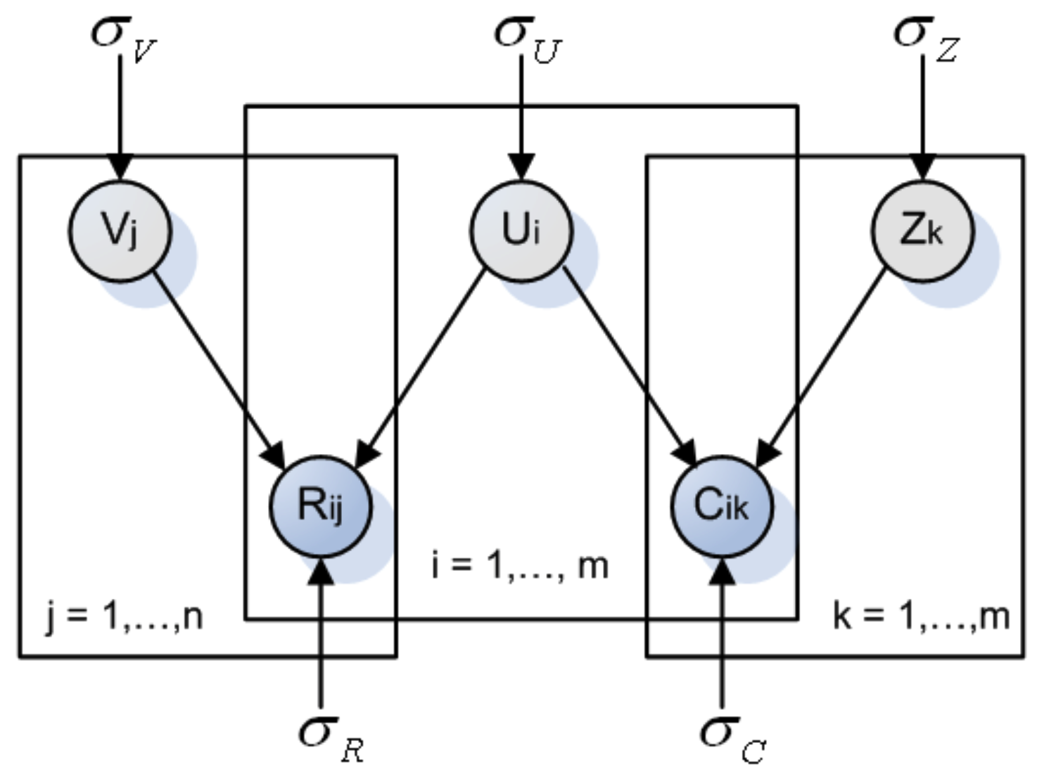
Model based Social Recommender
factor vector
SoRec
item vector
user vector
R: user-item
rating matrix
C: user-user
social matrix
Ma et al. Social Recommendation Using Probabilistic Matrix Factorization. CIKM, 2008.
Improving Recommender Systems by Incorporating Social Contextual Information. TIS, 2011.
Notes:
Optimize user vector with both rating matrix and social matrix with probabilistic graphical model.

Slide 27
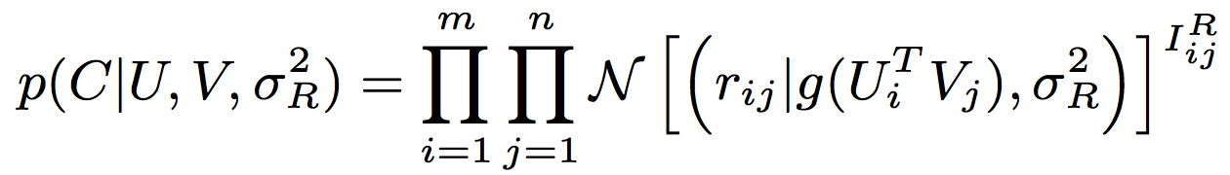
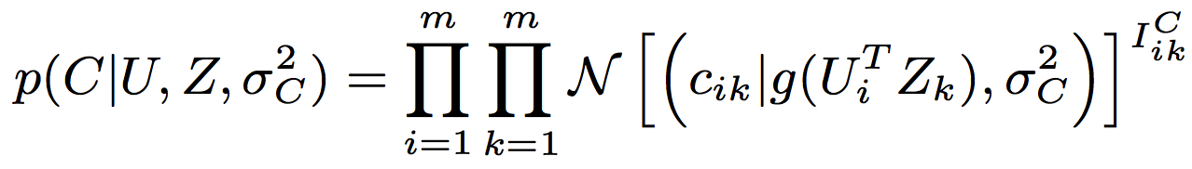
Model based Social Recommender
SoRec
R
Gaussian distribution
Logistic function
Observed
Notes:
Observation indicator, Gaussian distribution, logistic function.

Slide 28
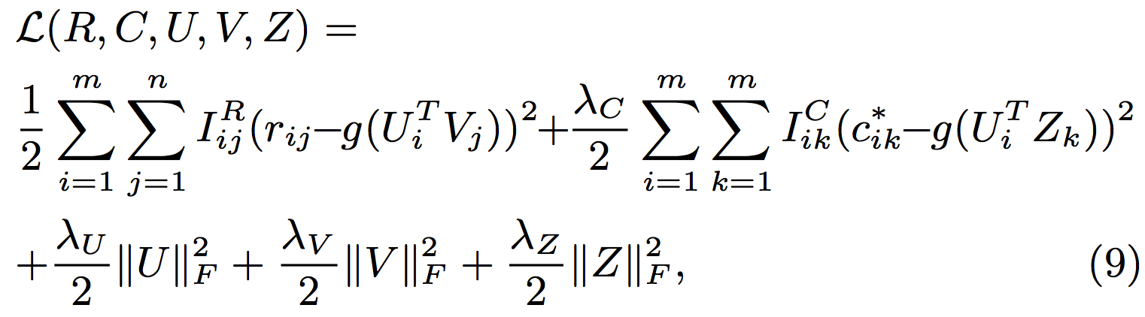
Model based Social Recommender
SoRec
behavioral term
social term
regularization terms
Notes:
Behavioral term, social term, regularization terms.

Slide 29
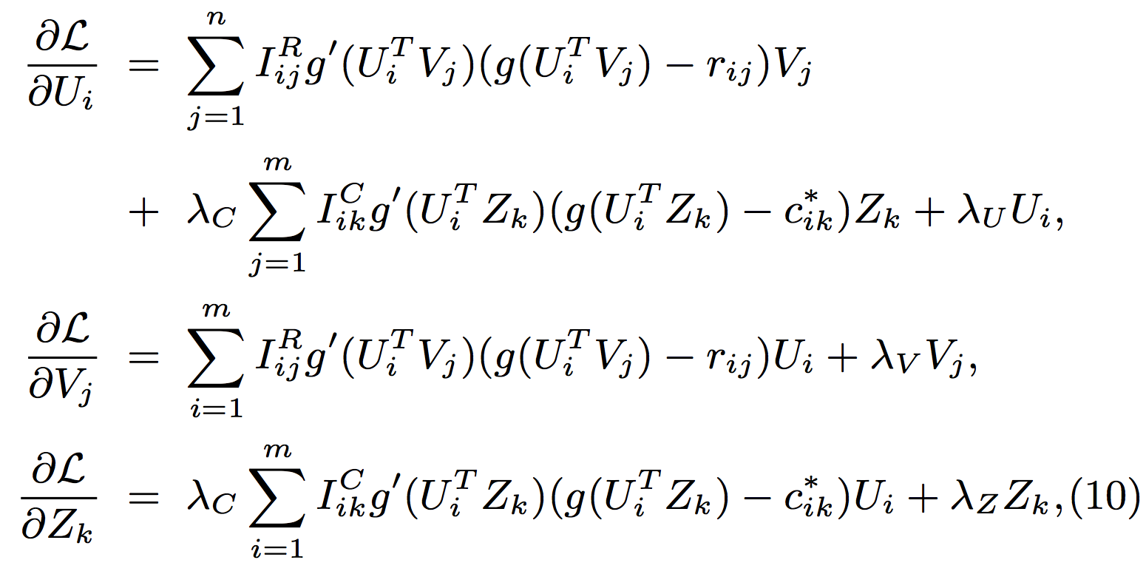
Model based Social Recommender
SoRec
Gradient Descent Methods
deviate of
Logistic
function

Slide 30
Model based Social Recommender
SoRec
Notes:
Review the whole framework of SoRec.

Slide 31
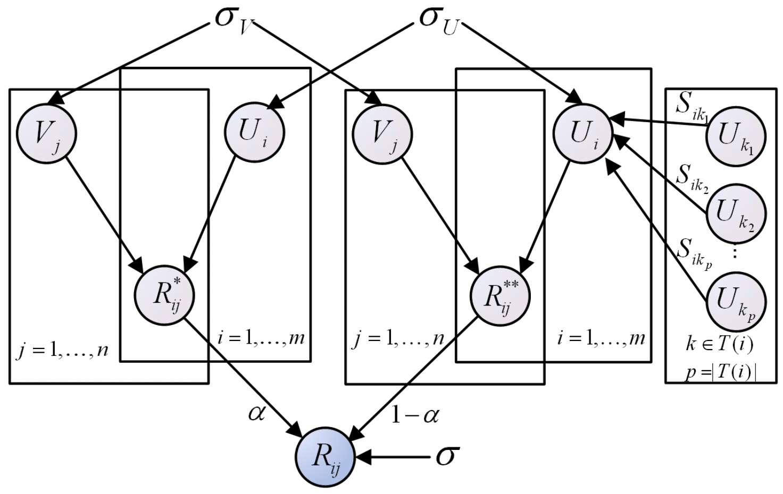
Model based Social Recommender
Replacing social with trust
“Social Trust” Ensemble for Epinion data
From user-item
matrix
From trusted friends
Operation “plus”
Ma et al. Learning to Recommend with Social Trust Ensemble. SIGIR, 2009.
Learning to Recommend with Explicit and Implicit Social Relations. TIST, 2011.
Notes:
Modeling social trust into the factorization framework: Rating and trust. Trade-off. Parameter alpha.

Slide 32
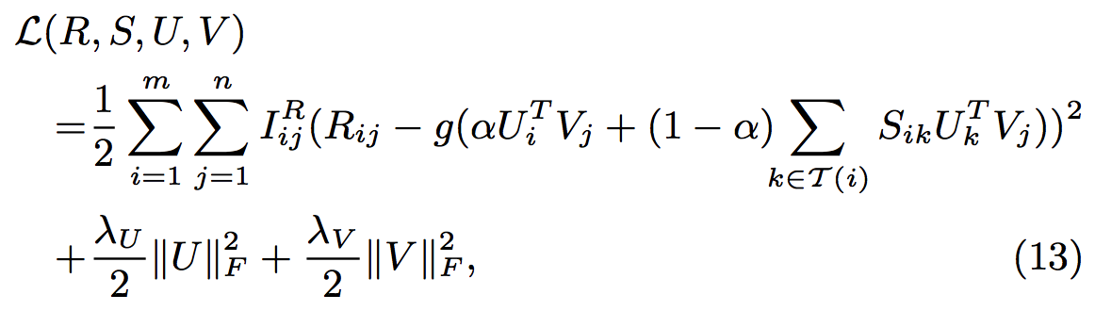
Model based Social Recommender
“Social Trust” Ensemble
From user-item
matrix
From trusted friends
Notes:
Trade-off.

Slide 33
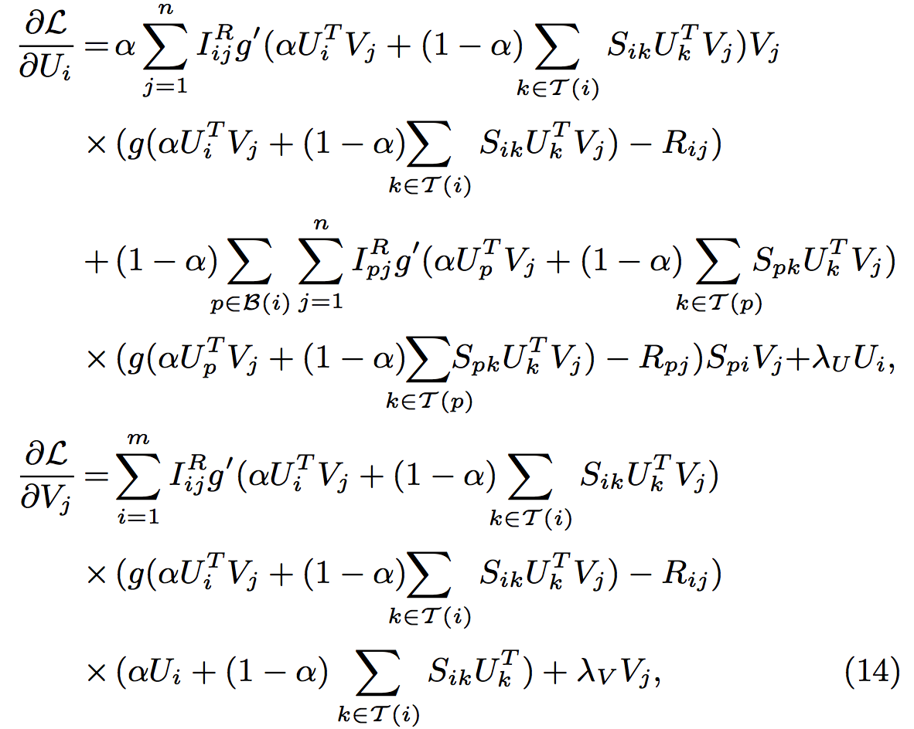
Model based Social Recommender
“Social Trust” Ensemble
Gradient
Descent
Methods

Slide 34
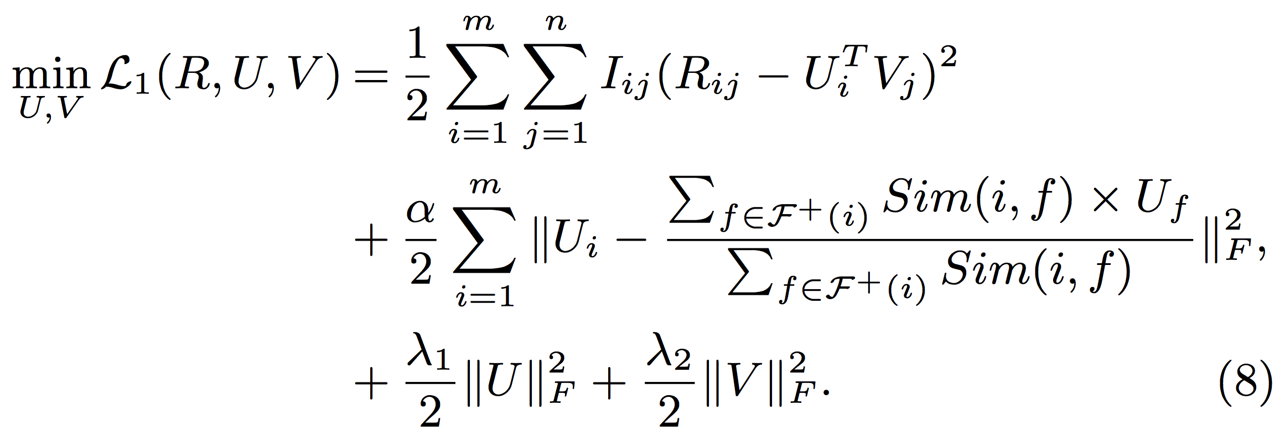
Model based Social Recommender
SoReg
Average-based regularization:
Regularize with the average of friends’ tastes
Information loss: Friends may have diverse tastes!!!
Ma et al. Recommender Systems with Social Regularization. WSDM, 2011.
Notes:
Your tastes are similar with the average tastes of your friends?

Slide 35
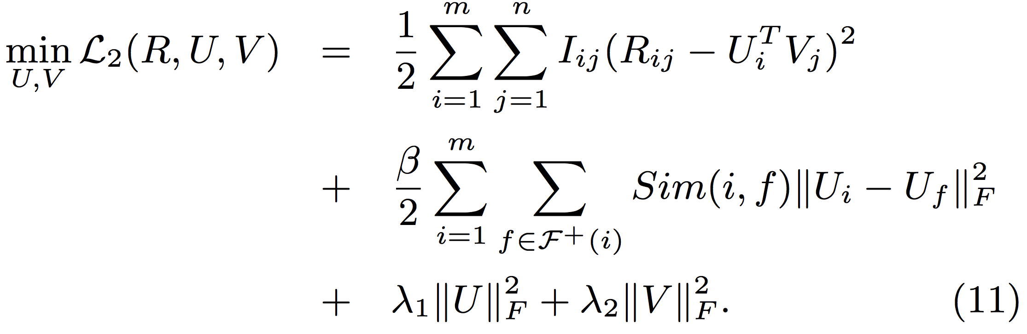
Model based Social Recommender
SoReg
Individual-based regularization:
Regularize with friends individually
Notes:
In fact, your tastes are similar with your friends who are strongly connected with you. This is better.

Slide 36
Related Work
Q: What are the factors of users’ decisions on retweeting? Can we observe them from the data? How to integrate the information for accurate prediction?
 | Behavior | Content | Social | Trust
Collaborative filtering (CF) [Herlocker et al. TOIS; Koren KDD] | ✔
Content-based filtering with CF [Balabanovic et al.; Liu et al. CIKM;] | ✔ | ✔
SoRec [Ma et al. CIKM, TIS] SoReg [Ma et al. WSDM] | ✔ |  | ✔
Trust-based methods [Massa et al. RecSys; Jamali et al. KDD; Ma et al. SIGIR, TIST] | ✔ |  |  | ✔

Slide 37
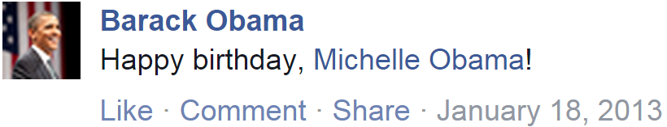
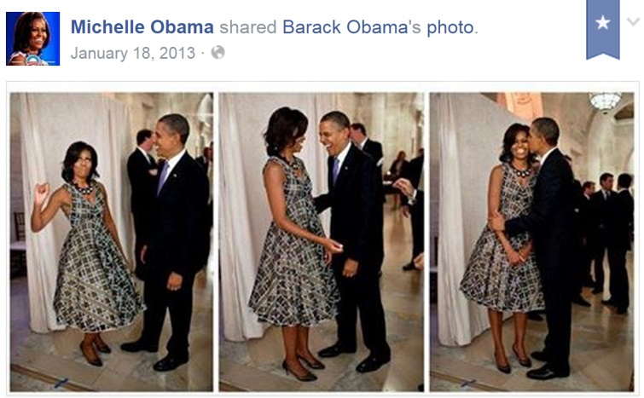
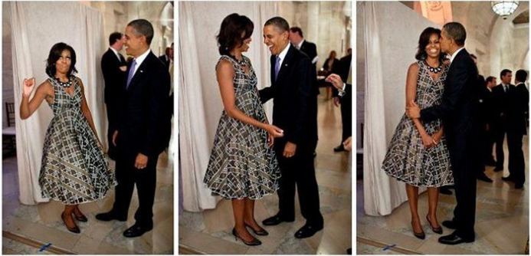
Observation: Social Contextual Factors
Will Michelle Obama share this message?
Please list your reasons.
Jiang et al. Social Contextual Recommendation. CIKM, 2012.
Social Recommendation with Contextual Information. TKDE, 2014.

Slide 38
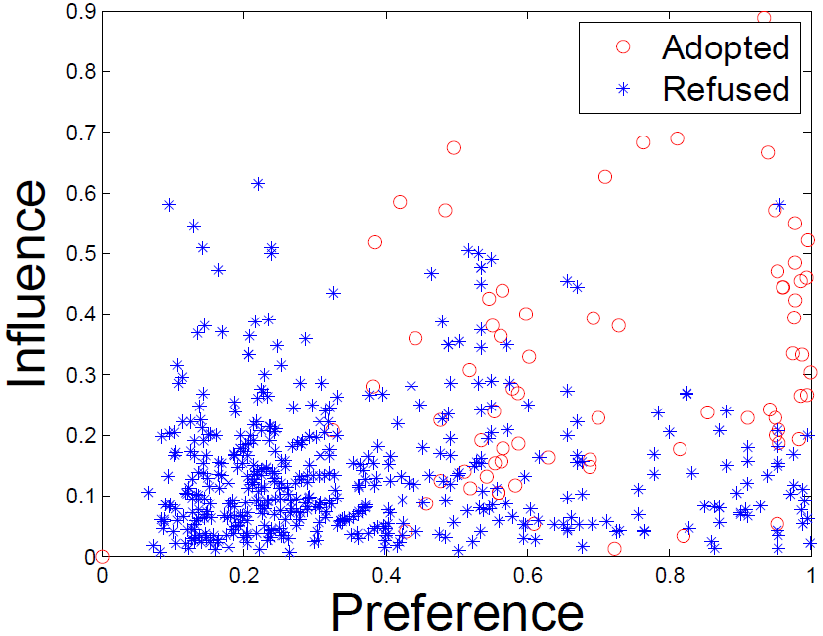
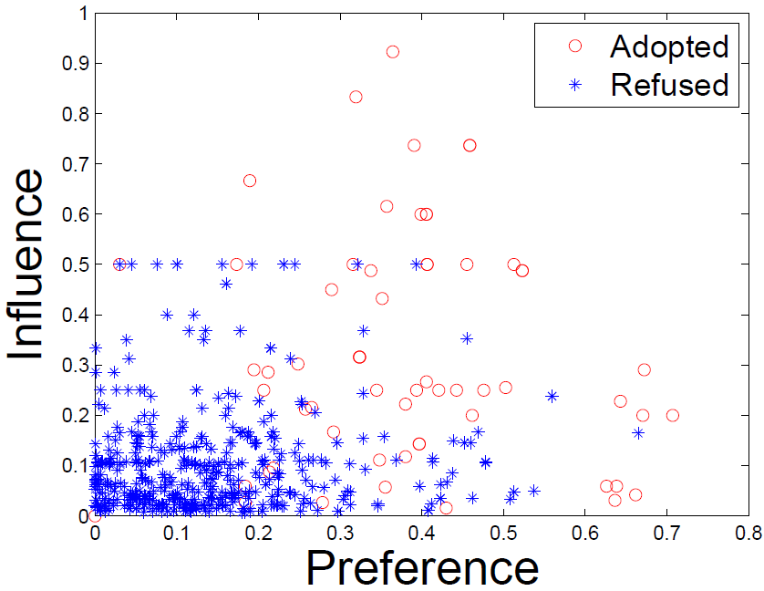
Observation: Social Contextual Factors
u
send
i
u
send
i
×
receive and retweet
receive but ignore
u
u
adopted
refused
↗
↗
China’s Facebook: Renren
China’s Twitter: Tencent Weibo

Slide 39
Representation: From Contextual Information to Contextual Factors
Content
Item-item similarity
Item latent features V
Personal preference
on the given item
Behavior
User-item interaction
User latent features U
Social
User-user social relation
Item sender G
Interpersonal influence
from the item’s sender
Interaction frequency
User-user interaction
User-user influence S

Slide 40
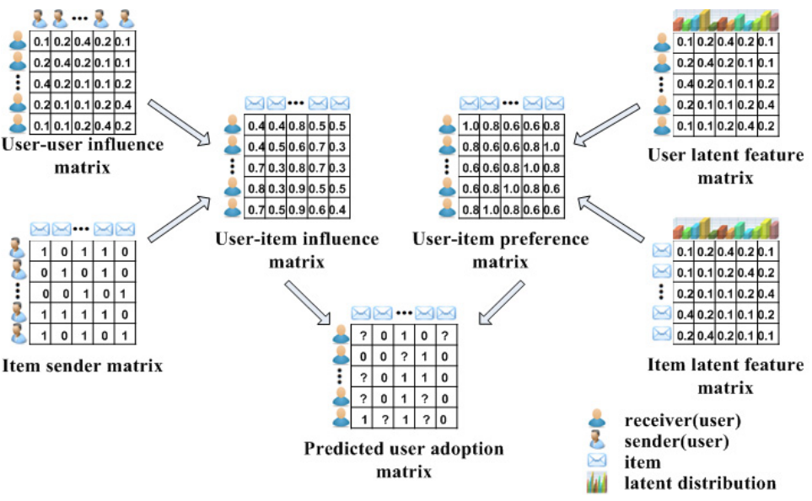
Model: ContextMF
S
U
G
V

Slide 41
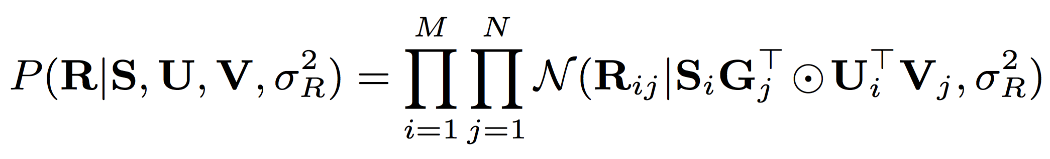
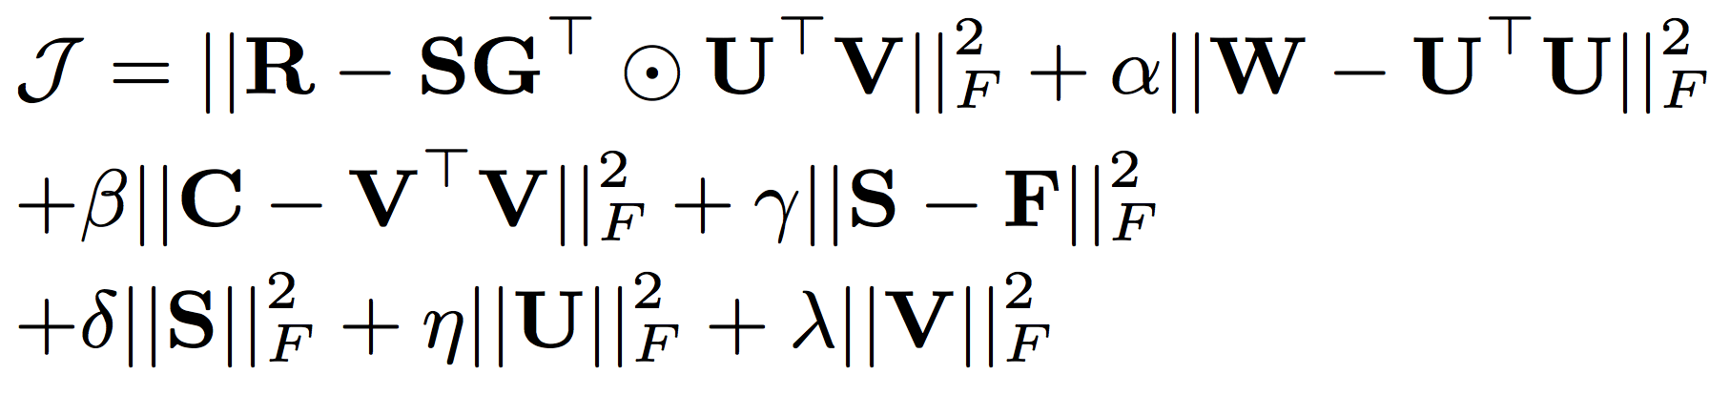
Model: ContextMF
behavior
influence
preference
behavior
interaction frequency/trust
item content
social relation

Slide 42
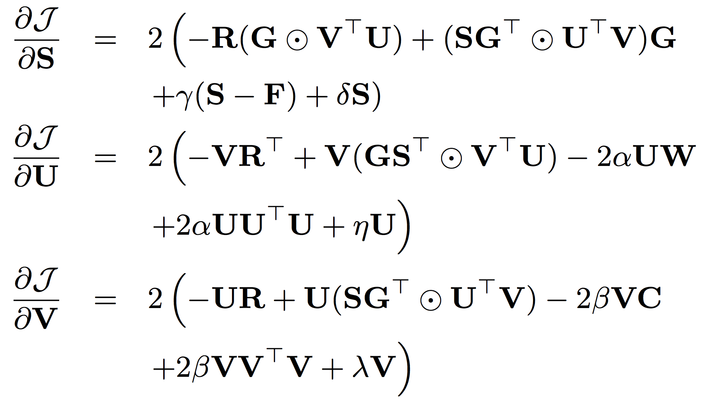
Model: ContextMF
Gradient descent method

Slide 43
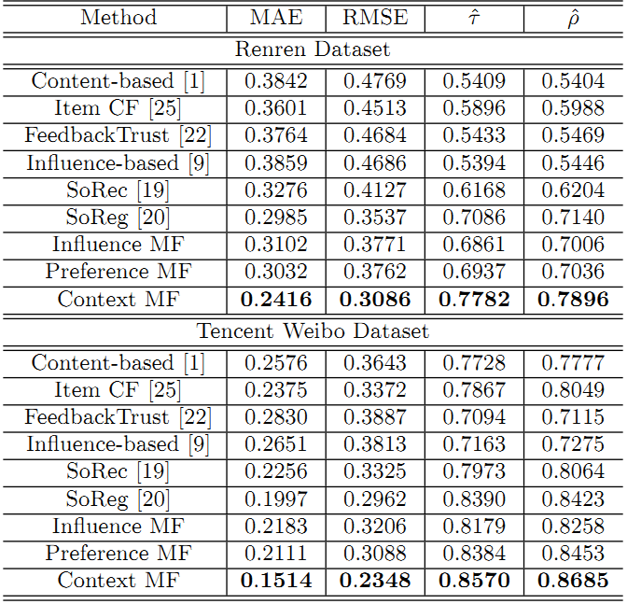
Experimental Results
vs. SoReg [TIST’11] | Renren | Tencent Weibo
MAE | ↓19.1% | ↓24.2%
RMSE | ↓12.8% | ↓20.7%
Kendall’s | ↑9.82% | ↑2.1%
Spearman’s | ↑10.6% | ↑3.1%
Deployed in Weibo News Feed. Improved conversion rate from 5.78% to 8.27% (relatively 43%).
#citations = 149

Slide 44



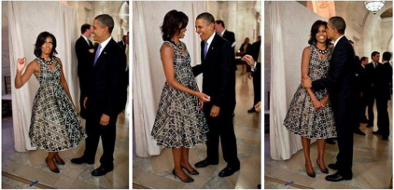
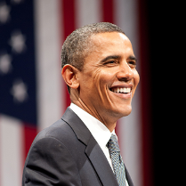
Observation: Spatial Context
Place
Device
Photo
With whom?
Who post?
Text
post
Jan. 18
Birthday party
@ White house
Jiang et al. Flexible Evolutionary Multi-faceted Analysis for Dynamic Behavioral Pattern Discovery. KDD, 2014.

Slide 45
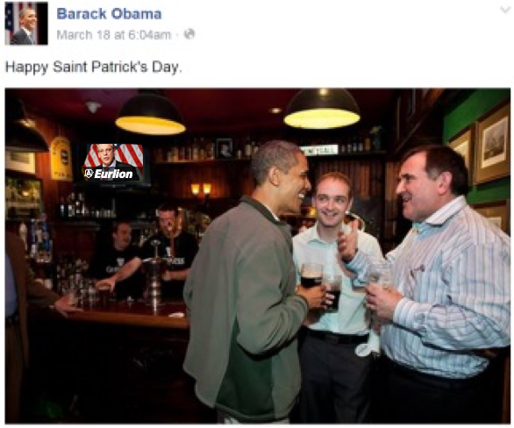
Observation: Temporal Context
Photo
Text
post
post
time
Jan. 18
Birthday party
@ White house
March 17
St. Patrick’s Day
@ Bar

Slide 46
Representation: Tensor Sequence
Tasks
time
Who post
Text
Behavior
Place
Behavior modeling
Spatial info:
Multi-faceted
Tensor sequence
Temporal info:
Dynamic
Pattern discovery
Decomposition & Completion
Behavior prediction
≈
x
x

Slide 47
Challenges: Sparsity and Complexity
Addressing sparsity: Flexible regularization with auxiliary data
Addressing high complexity: Incremental updates for projection matrix
Regularization:
Social context
user
item
…
user
item
time
t₃
t₂
time
item
item
t₁
user
user
t₁
t₂
t₃

Slide 48
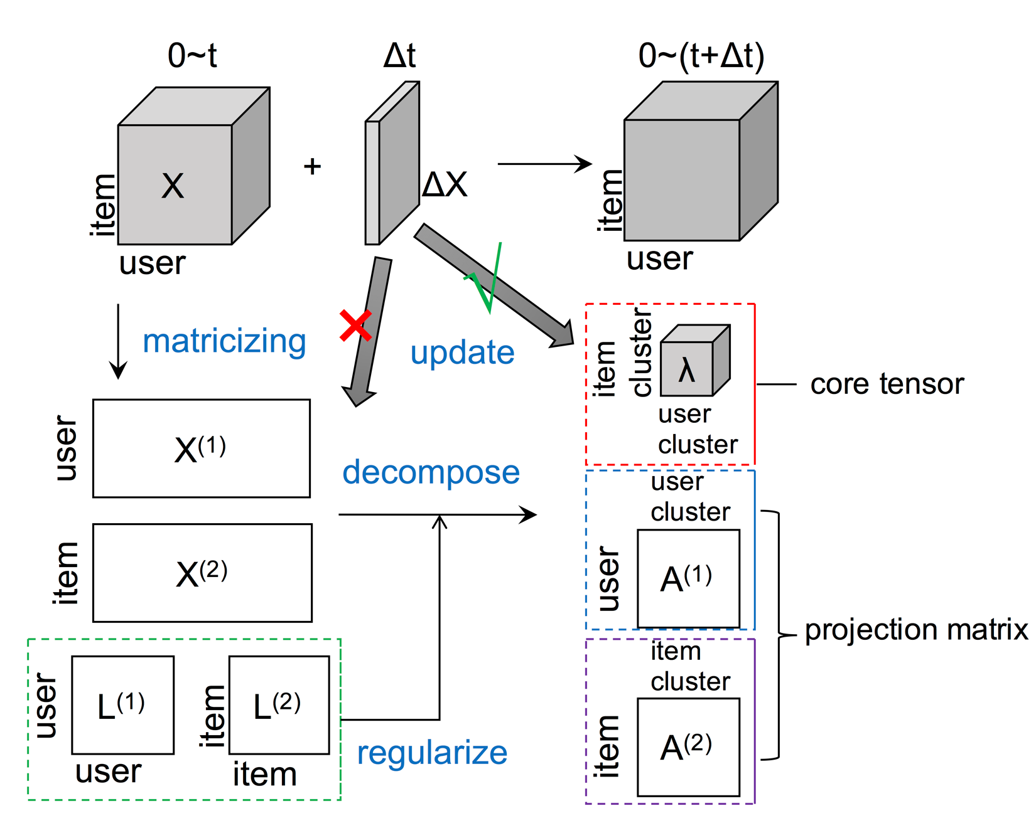
Model: FEMA Flexible Evolutionary Multi-faceted Analysis

Slide 49
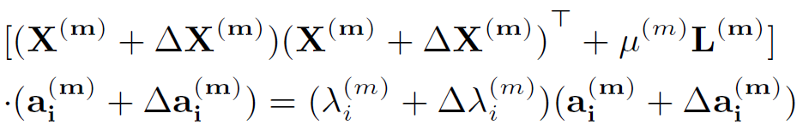
Tensor Perturbation Theory

Slide 50
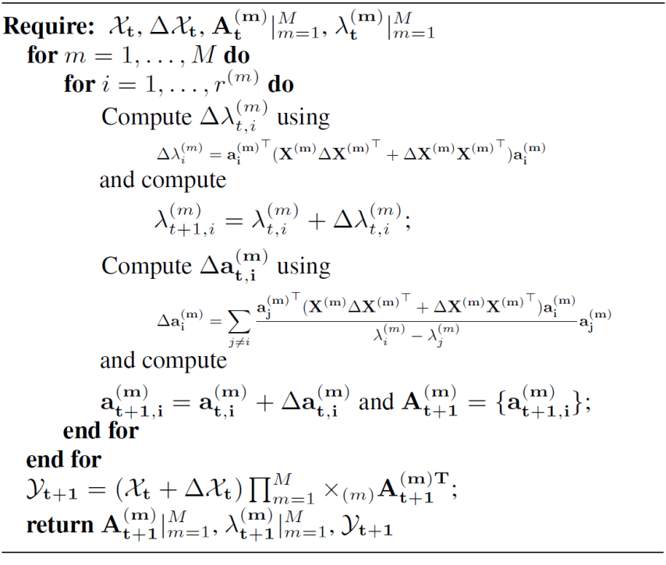
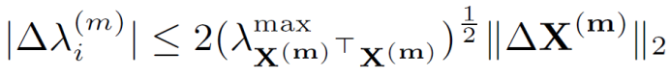
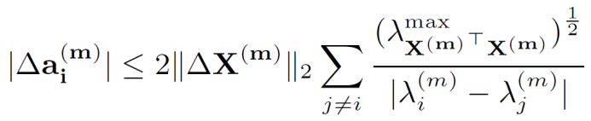
Algorithm: FEMA
Approximation
Bound Guarantee
core tensor
projection matrix

Slide 51
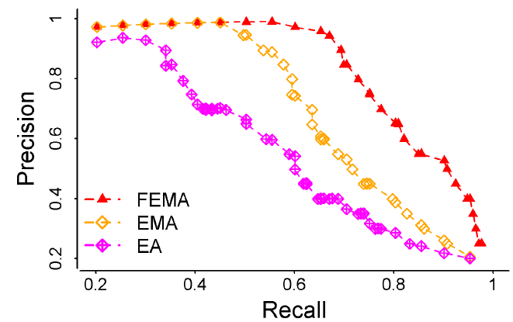
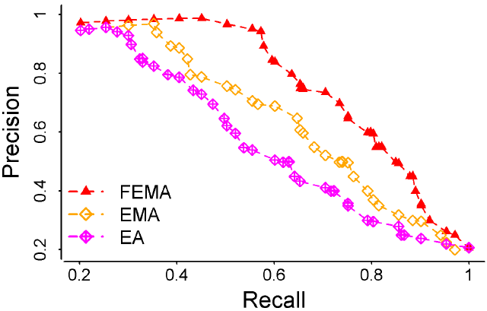
Results: FEMA > EMA > EA
 | Microsoft Academic Search |  | Tencent Weibo mentions “@”
 | MAE | RMSE | MAE | RMSE
FEMA | 0.735 | 0.944 | 0.894 | 1.312
EMA | 0.794 | 1.130 | 0.932 | 1.556
EA | 0.979 | 1.364 | 1.120 | 1.873
Precision vs Recall
X
L
X
X

Slide 52
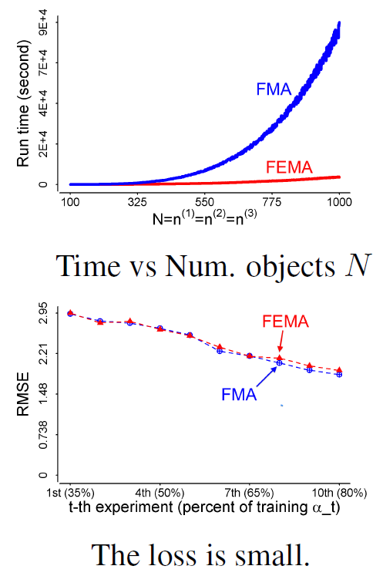
Results: Efficiency
Re-decomposition:
Re-compute projection matrices
Evolutionary analysis:
Use ΔX to update λ and a
Evolutionary analysis:
Use ΔX to update λ and a
Re-decomposition:
Re-compute projection matrices

Slide 53

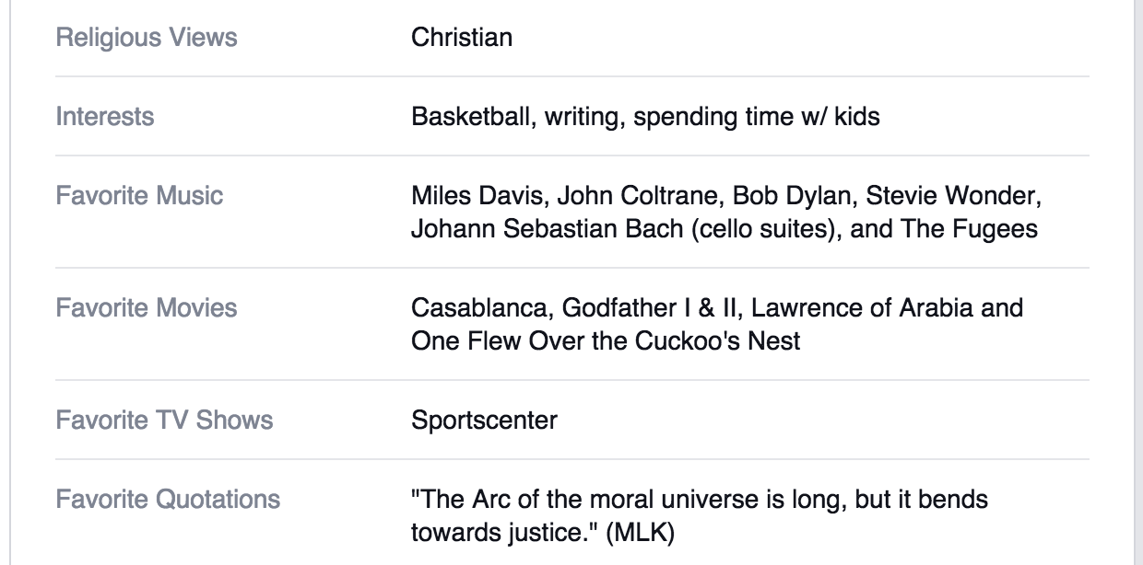



Observation: Multiple Domains
Jiang et al. Social Recommendation across Multiple Relational Domains. CIKM, 2012.
Social Recommendation with Cross-Domain Transferable Knowledge. TKDE, 2015.

Slide 54

Representation: Star-Structured Graph

Slide 55
Representation: Social Bridge
Rtgt
Raux1
Raux3
Raux2
Bridge: Tie strength

Slide 56






Algorithm: Hybrid Random Walk
Updating cross-domain links
Updating within-domain links

Slide 57



Results
Comparing with Random Walk with Restarts Models
Comparing with Social Recommendation Baselines

Slide 58

Results: Insight
Knowledge transfer from auxiliary domains improves cold-start users’ behavior prediction
Using aux. (label) data, saving 60-70% tgt. (post) data
35% user-post
0 user-label
0 user-post
100% user-label
60% user-post
0 user-label
18% user-post
100% user-label

Slide 59
Observation: Multiple Platforms
Jiang et al. Little is Much: Bridging Cross-Platform Behaviors through Overlapped Crowds. AAAI, 2016.

Slide 60

Observation: Cross-Platform

Slide 61



Observation: Partially Overlapped Crowds

Slide 62

Representation: When NO Transfer
Sina Weibo
tags/entities
Douban
movies/books
User set | Weibo tweet entity to Douban movie
 | RMSE | MAP
A | Auxiliary platform data!
C | 0.779 | 0.805
B | 1.439 | 0.640
Sina Weibo
users
A
C
Douban
users
B
User set | Douban book to Weibo social tag
 | RMSE | MAP
A | 0.429 | 0.464
C | 0.267 | 0.666
B | Auxiliary platform data!

Slide 63

Algorithm: XPTrans

Slide 64

Algorithm: XPTrans
Input
Tgt./Aux. platform P/Q;
Behavior data R(P)/R(Q);
Observation W(P)/W(Q);
Overlapping indicator W(P,Q),
Output
User latent representation U(P)/U(Q);
Item latent representation V(P)/V(Q);
Missing values in R(P)
Objective function
Target platform
Auxiliary platform
Overlapping user similarity
(Pair-wise regularization)

Slide 65
Results: Leveraging Auxiliary Platform Data
Transfer via the Same
Latent Space
NO Transfer
User set | Weibo tweet entity to Douban movie
 | RMSE | MAP
A | Auxiliary platform data!
C | 0.779 | 0.805
B | 1.439 | 0.640
User set | Weibo tweet entity to Douban movie
 | RMSE | MAP
A
C | 0.757 | 0.811
B | 1.164 (-19%) | 0.702 (+9.7%)
User set | Douban book to Weibo social tag
 | RMSE | MAP
A | 0.429 | 0.464
C | 0.267 | 0.666
B | Auxiliary platform data!
User set | Douban book to Weibo social tag
 | RMSE | MAP
A | 0.411 (-4.2%) | 0.487 (+5.0%)
C | 0.256 | 0.681
B

Slide 66
Results: Leveraging Different Latent Spaces
Transfer via the Same
Latent Space
Transfer via Different
Latent Spaces
User set | Weibo tweet entity to Douban movie
 | RMSE | MAP
A
C | 0.757 | 0.811
B | 1.164 | 0.702
User set | Weibo tweet entity to Douban movie
 | RMSE | MAP
A
C | 0.715 | 0.821
B | 0.722 (-38%) | 0.820 (+17%)
User set | Douban book to Weibo social tag
 | RMSE | MAP
A | 0.411 | 0.487
C | 0.256 | 0.681
B
User set | Douban book to Weibo social tag
 | RMSE | MAP
A | 0.374 (-11%) | 0.533 (+12%)
C | 0.236 | 0.705
B

Slide 67
Results: Where Amazing Happens
Transfer via Different
Latent Spaces
NO Transfer
User set | Weibo tweet entity to Douban movie
 | RMSE | MAP
A | Auxiliary platform data!
C | 0.779 | 0.805
B | 1.439 | 0.640
User set | Weibo tweet entity to Douban movie
 | RMSE | MAP
A
C | 0.715 | 0.821
B | 0.722 | 0.820
User set | Douban book to Weibo social tag
 | RMSE | MAP
A | 0.429 | 0.464
C | 0.267 | 0.666
B | Auxiliary platform data!
User set | Douban book to Weibo social tag
 | RMSE | MAP
A | 0.374 | 0.533
C | 0.236 | 0.705
B

Slide 68

Results: Different Sizes of Latent Spaces

Slide 69
Summary
Like, Reply, Share, Retweet, Favorite, Comment …
Memory based social recommenders
TidalTrust, MoleTrust, TrustWalker
Model based social recommenders
SoRec, “Social Trust” Ensemble, SoReg
Observations, Representations, Models
ContextMF: Social contexts (preference & influence)
FEMA: Spatiotemporal contexts (multidimensional)
HybridRW: Cross-domain behavior modeling
XPTrans: Cross-platform behavior modeling

Slide 70
I. Mining behavior networks with social and spatiotemporal contexts
I.2. Suspicious behavior detection

Slide 71

Ill-gotten Facebook Likes

Slide 72

Suspicious Behavior Detection
Social Link Farming
Meng Jiang, Peng Cui and Christos Faloutsos.
Suspicious Behavior Detection: Current Trends and Future Directions.
IEEE Intelligent Systems (ISSI), 2016.

Slide 73

Ill-gotten Facebook Likes
Beutel et al. CopyCatch: Stopping Group Attacks by Spotting Lockstep Behavior in Social Neworks. WWW, 2013.

Slide 74

Observation: Graphical View

Slide 75

Observation: Reorder Matrix

Slide 76

Algorithm: Seed + Search
CopyCatch
“Near Bipartite Core”: n users, m Pages, ρ, Δt

Slide 77

Experimental Result
Seed Selection!!!

Slide 78

Serious Problem in Weibo
Experience-driven approaches:
features of #followees, #hashtags, #URLs…
×

Slide 79


Zombie Followers
Follow
× 1,000
× 100
× 5,000
× 100
× ….
× ….
Jiang et al. Inferring Strange Behavior from Connectivity Pattern in Social Networks. PAKDD, 2014.

Slide 80




Observation: Reorder Matrix
Seeds
Given
Reorder

Slide 81
Representation: SVD Reminder
followee
followee
U₁U₂
×
…
V₁V₂
×
follower
follower
×
1
follow
2
×
Graph Structure
Adjacency Matrix
SVD: A=USV^{T}

Slide 82
Representation: Spectral Subspace
followee
U₁U₂
…
V₁V₂
follower
Pairs of singular vectors:
SVD: A=USV^{T}
U₂
V₂
U₁
V₁
“Spectral Subspace Plot”

Slide 83


Spectral Subspace Plot: Case #0
NO lockstep behavior: Scatter
Adjacency Matrix
Spectral Subspace Plot

Slide 84

Spectral Subspace Plot: Case #1
Non-overlapping lockstep: “Rays”
Adjacency Matrix
Spectral Subspace Plot

Slide 85

Spectral Subspace Plot: Case #2
Non-overlapping: Low density, Elongation
Adjacency Matrix
Spectral Subspace Plot

Slide 86

Spectral Subspace Plot: Case #3
Non-overlapping: Camouflage/Fame, Tilting
Adjacency Matrix
Spectral Subspace Plot

Slide 87

Spectral Subspace Plot: Case #4
Overlapping: “Staircase”, “Pearls”
Adjacency Matrix
Spectral Subspace Plot

Slide 88

Algorithm: Reading & LockInfer
Spectral
Subspace Plot
Polar Coordinate
Transform
Histograms
High precision but low recall!!!

Slide 89



Out-Degree Distributions
Power-law distribution [Faloutsos et al. SIGCOMM; Broder et al. Computer Networks; Chung et al. PNAS]
DBLP Author-publication | Flickr User-user | Twitter Who-follows-whom
[konect.uni-koblenz.de/networks/]

Slide 90




Spikes!
2009
41M
2011
117M
3.17M
1.91M
0.41M
0.44M
d=20
d=64

Slide 91

Observation: How They Behave
Feature space of followees [Kleinberg. JACM]
President Barack Obama
Meng Jiang

Slide 92

Observation: How They Behave
Who are their followees?
Their behavioral pattern
Synchronized
Similar with each other
Abnormal
Different from the majority
Meng Jiang
#followee=117
BuyAB22
#followee=20

Slide 93



Represent Synchronicity
>

Slide 94

Represent Normality
<

Slide 95

Theorem: Synchronicity vs. Normality
G grids
fp_{g}: #foreground points in grid g
∑fp_{g} = F = d(u) (#followees of u)
Given normality
n = ∑(fp_{g}/F) (bp_{g}/B) = ∑f_{g}b_{g},
find minimal synchronicity
s = ∑(fp_{g}/F) (fp_{g}/F) = ∑f_{g}²
where
∑f_{g} = 1, ∑b_{g} = 1
bp_{g}: #background points in grid g
∑bp_{g} = B = N (#all users)

Slide 96
Theorem: Synchronicity vs. Normality
G grids
Solution.
Lagrange multiplier:
minimize s(f_{g}) = ∑f_{g}²
subject to ∑f_{g} = 1, ∑f_{g}b_{g} = n
Lagrange function:
F(f_{g}, λ, μ) = (∑f_{g}²) + λ(∑f_{g} – 1) + μ(∑f_{g}b_{g} – n)
Gradients:
▽f_{g}F = 2 f_{g} + λ + μ b_{g} = 0
▽λF = ∑f_{g} – 1 = 0
▽μF = ∑f_{g}b_{g} – n = 0
2 + λ G + μ = 0
2 n + λ + μ s_{b} = 0
2 s_{min} + λ + μ n = 0
where s_{b} = ∑b_{g}².
Therefore,
– G n² + 2 n – s_{b}
1 – G s_{b}
∑
× b_{g} ∑
× f_{g} ∑
s_{min} =

Slide 97

CatchSync Algorithm
G grids
– G n² + 2 n – s_{b}
1 – G s_{b}
s_{min} =
BuyAB22
Meng
Jiang

Slide 98
Experimental Results
CatchSync+SPOT
CatchSync
SPOT
OutRank
CatchSync+SPOT
CatchSync
SPOT
OutRank

Slide 99


Experimental Results
3.17M
0.41M
d=20

Slide 100
Impact
M. Jiang, P. Cui, A. Beutel, C. Faloutsos and S. Yang. “CatchSync: Catching Synchronized Behavior in Large Directed Graphs” in KDD’14 Best Paper Finalist, Aug 2014. (#citations = 36)
Taught in
CMU 15-826: Multimedia Databases and Data Mining
UMich EECS 598: Graph Mining and Exploration at Scale
ASONAM’16 Tutorial: “Identifying Malicious Actors on Social Media” by S. Kumar, F. Spezzano, V.S. Subrahmanian
Deployed in Weibo? Unfortunately, in July 2014…
Notes:
[36] [26]

Slide 101
Observation: Spatiotemporal Contexts
Dataset | Dimension/Mode |  |  |  | Mass
Weibo’s Retweeting | User | Root ID | IP | Time (min) | #retweet
 | 29.5M | 19.8M | 27.8M | 56.9K | 211.7M
Weibo’s Trending (Hashtag) | User | Hashtag | IP | Time (min) | #tweet
 | 81.2M | 1.6M | 47.7M | 56.9K | 276.9M
Network attacks (LBNL) | Src-IP | Dest-IP | Port | Time (sec) | #packet
 | 2,345 | 2,355 | 6,055 | 3,610 | 230,836
Jiang et al. A General Suspiciousness Metric for Dense Blocks in Multimodal Data. ICDM, 2015.

Slide 102


Dense Block Indicates Suspiciousness
200 minutes
120 minutes
time
time
user
225
user
40
IP
12,375
2
27,313
Q: Which is more suspicious?
We need a metric to evaluate the suspiciousness.

Slide 103
Criteria for Suspiciousness Metric
What properties are required of a good metric?
N₁ ⨉ N₂ ⨉ N₃
Count data with total “mass” C
f(
)
f(
n’₁ ⨉ n’₂ ⨉ n’₃
mass c’
density ρ’
)
n₁ ⨉ n₂ ⨉ n₃
mass c
density ρ
vs

Slide 104

Axioms: 1 to 4

Slide 105
Axiom 5: Cross Dimensions
Not including a mode is the same as
including all values for that mode.
=
▶ New information (more modes) can only
make our blocks more suspicious

Slide 106
Scoring the Suspiciousness
200 minutes
120 minutes
time
time
user
225
user
40
IP
12,375
2
27,313
Q: Which is more suspicious?

Slide 107
Scoring the Suspiciousness
200 minutes
120 minutes
time
time
user
225
user
40
IP
12,375
2
27,313
Probability
0.9%
0.05%

Slide 108

A General Suspiciousness Metric
Negative log likelihood of block’s probability

Slide 109

CrossSpot Algorithm
Local search to maximize the metric
Start with seed blocks
Parameter-free: iteratively update the blocks
Scalable: parallelize to multiple machines

Slide 110

Advantages

Slide 111

Results: Dense Block Detection
Synthetic data
1,000×1,000×1,000 of 10,000 random data
Block#1: 30×30×30 of 512 3 modes
Block#2: 30×30×1,000 of 512 2 modes
Block#3: 30×1,000×30 of 512 2 modes
Block#4: 1,000×30×30 of 512 2 modes

Slide 112


Results: Tweeting Hashtags

Slide 113
Results: Network Attacks

Slide 114
Summary
Ill-gotten Facebook Likes, Zombie Followers
Observations, Representations, Models
CopyCatch: Catching ill-gotten Likes by core search
LockInfer: Adding seed selection before search
CatchSync: Catching smart zombie followers with high recall (recovering power-law distributions)
CrossSpot: Defining suspiciousness across dimensions

Slide 115
II. Structuring behavioral content and integrating behavioral analysis with information networks

Slide 116
Data to Network to Knowledge
Information Network
(entities, attributes, relationships)
Structuring
Integration
Rich unstructured text data
Behavior Network
tweets, news, msgs…
u
t
product/restaurant review…
i
l
publications (abstract/full text):
PubMed, dblp, acmdl
a
Structured data
h
@

Slide 117
Construction of Heterogeneous Information Networks from Text
💡Philosophy: Not extensive “labeling” but exploring the power of massive text corpora!
Mining phrases (the minimal semantic units)
Entity recognition and typing
Attribute discovery (entity, attribute name, value)
Enrique Pena Nieto
…here by Canada Prime Minister Justin Trudeau, 43, the so-called #APEChottie…of Mexico’s Enrique Pena Nieto, 49, … United States President Barack Obama, 53, who…
Prime Minister
age
49
Mexico
Prime Minister
Canada
Justin Trudeau
President
age
43
U.S.
$Location.Country
Barack Obama
age
53
$Person

Slide 118
Construction of Heterogeneous Information Networks from Text
💡Philosophy: Not extensive “labeling” but exploring the power of massive text corpora!
Mining phrases (the minimal semantic units)
Entity recognition and typing
Attribute discovery (entity, attribute name, value)
Enrique Pena Nieto
…here by Canada Prime Minister Justin Trudeau, 43, the so-called #APEChottie…of Mexico’s Enrique Pena Nieto, 49, … United States President Barack Obama, 53, who…
Prime Minister
age
49
Mexico
Prime Minister
Canada
Justin Trudeau
President
age
43
U.S.
$Location.Country
Barack Obama
age
53
$Person

Slide 119


Why Mining Phrases?
Unigrams are ambiguous but phrases are natural, unambiguous semantic units
Ex.: “United” vs. United States, United Airline, United Parcel Service
Mining semantically meaningful phrases
Transform text data from word granularity to phrase granularity
Enhance the power at manipulating unstructured data using information networks
Phrase mining: Most NLP methods may need annotation and training
Annotate hundreds of documents as training data
Train a supervised model based on part-of-speech features
Limitations: High annotation cost
May not be scalable to domain-specific, dynamic, emerging applications
Scientific domains, query logs, or social media, e.g., Yelp, Twitter
Minimal/no training but making good use of massing corpora

Slide 120
Strategies for Phrase Mining
Strategy 1: Simultaneously inferring phrases and topics
Bigram topical model [Wallach’06], topical n-gram model [Wang, et al.’07], phrase discovering topic model [Lindsey, et al.’12]
High model complexity: Tends to overfitting; High inference cost: Slow
Strategy 2: Post topic modeling phrase construction
Label topic [Mei et al.’07], TurboTopic [Blei & Lafferty’09], KERT [Danilevsky, et al.’14]
Words in the same phrase may be assigned to different topics
Ex. … knowledge discovery using least squares support vector machine …
Our solution 1: ToPMine [El-kishky, et al., VLDB’15]
First Phrase Mining then Topic Modeling (No training data at all)
Our solution 2: SegPhrase+ [Liu, et al., SIGMOD’15]
Integrating phrase mining and document segmentation (with minimal training data)

Slide 121
ToPMine: The Overall Phrase Mining Framework
ToPMine [El-Kishky et al. VLDB’15]
First phrase construction, then topic mining
Contrast with KERT: First topic modeling, then phrase mining
The ToPMine Framework:
Perform frequent contiguous pattern mining to extract candidate phrases and their counts
Perform agglomerative merging of adjacent unigrams as guided by a significance score—This segments each document into a “bag-of-phrases”
The newly formed bag-of-phrases are passed as input to PhraseLDA, an extension of LDA, that constrains all words in a phrase to each sharing the same latent topic

Slide 122


Phrase Mining: Frequent Pattern Mining + Statistical Analysis
Quality phrases
Based on significance score [Church et al.’91]:
α(P₁, P₂) ≈ (f(P₁●P₂) ̶ µ₀(P₁,P₂)) / f(P₁●P₂)^{1/2}
[Markov blanket] [feature selection] for [support vector machines]
[knowledge discovery] using [least squares] [support vector machine] [classifiers]
…[support vector] for [machine learning]…
Phrase | Raw freq. | True freq.
[support vector machine] | 90 | 80
[vector machine] | 95 | 0
[support vector] | 100 | 20

Slide 123
What Kind of Phrases are of “High Quality”?
Judging the quality of phrases
Popularity
“information retrieval” vs. “cross-language information retrieval”
Concordance
“powerful tea” vs. “strong tea”
“active learning” vs. “learning classification”
Informativeness
“this paper” (frequent but not discriminative, not informative)
Completeness
“vector machine” vs. “support vector machine”

Slide 124


ToPMine: Experiments on Yelp Reviews

Slide 125


ToPMine: Faster and Generating Better Quality Phrases
Running time of different algorithms
Phrase quality measured by z-score

Slide 126


SegPhrase: From Raw Corpus to Quality Phrases and Segmented Corpus
Raw Corpus
Quality Phrases
Segmented Corpus
Document 1
Citation recommendation is an interesting but challenging research problem in data mining area.
Document 2
In this study, we investigate the problem in the context of heterogeneous information networks using data mining technique.
Document 3
Principal Component Analysis is a linear dimensionality reduction technique commonly used in machine learning applications.
+ A small set of labels
or a general KB
Input Raw Corpus
Quality Phrases
Segmented Corpus
Phrase Mining
Phrasal Segmentation
Integrating phrase mining with phrasal segmentation
J. Liu et al. Mining Quality Phrases from Massive Text Corpora. SIGMOD, 2015 (won Grand Prize in Yelp Dataset Challenge).

Slide 127
Experiments: Interesting Phrases Generated (From the Titles and Abstracts of SIGMOD)
Query | SIGMOD
Method | SegPhrase+ | Chunking (TF-IDF & C-Value)
1 | data base | data base
2 | database system | database system
3 | relational database | query processing
4 | query optimization | query optimization
5 | query processing | relational database
… | … | …
51 | sql server | database technology
52 | relational data | database server
53 | data structure | large volume
54 | join query | performance study
55 | web service | web service
… | … | …
201 | high dimensional data | efficient implementation
202 | location based service | sensor network
203 | xml schema | large collection
204 | two phase locking | important issue
205 | deep web | frequent itemset
… | … | …
Only in SegPhrase+
Only in Chunking

Slide 128
Mining Quality Phrases in Multiple Languages
Rank | Phrase | In English
… | … | …
62 | 首席_执行官 | CEO
63 | 中间_偏右 | Middle-right
… | … | …
84 | 百度_百科 | Baidu Pedia
85 | 热带_气旋 | Tropical cyclone
86 | 中国科学院_院士 | Fellow of Chinese Academy of Sciences
… | … | …
1001 | 十大_中文_金曲 | Top-10 Chinese Songs
1002 | 全球_资讯网 | Global Info Website
1003 | 天一阁_藏_明代_科举_录_选刊 | A Chinese book name
… | … | …
9934 | 国家_戏剧_院 | National Theater
9935 | 谢谢_你 | Thank you
… | … | …
Both ToPMine and SegPhrase+ are extensible to mining quality phrases in multiple languages
SegPhrase+ on Chinese (From Chinese Wikipedia)
ToPMine on Arabic (From Quran Fus7a Arabic)(no preprocessing)
Experimental results of Arabic phrases:
كفروا → Those who disbelieve
بسم الله الرحمن الرحيم→ In the name of God the Gracious and Merciful

Slide 129
Construction of Heterogeneous Information Networks from Text
💡Philosophy: Not extensive “labeling” but exploring the power of massive text corpora!
Mining phrases (the minimal semantic units)
Entity recognition and typing
Attribute discovery (entity, attribute name, value)
Enrique Pena Nieto
…here by Canada Prime Minister Justin Trudeau, 43, the so-called #APEChottie…of Mexico’s Enrique Pena Nieto, 49, … United States President Barack Obama, 53, who…
Prime Minister
age
49
Mexico
Prime Minister
Canada
Justin Trudeau
President
age
43
U.S.
$Location.Country
Barack Obama
age
53
$Person

Slide 130
Why Entity Recognition and Typing from Massive Corpora?
Traditional named entity recognition systems are designed for major types (e.g., PER, LOC, ORG) and general domains (e.g., news)
Require additional steps to adapt to new domains/types
Expensive human labor on annotation
500 documents for entity extraction; 20,000 queries for entity linking
Unsatisfying agreement due to various granularity levels and scopes of types
Entities obtained by entity linking techniques have limited coverage and freshness
> 50% unlinkable entity mentions in Web corpus [Lin et al., EMNLP’12]
> 90% in our experiment corpora: tweets, Yelp reviews, …
A new approach: ClusType: Entity Recognition and Typing by Relation Phrase-Based Clustering [Ren, et al., KDD 2015]
Recognizing entity mentions of target types with minimal/no human supervision and with no requirement that entities can be found in a KB (distant supervision)

Slide 131



Recognizing Typed Entities
Identifying token span as entity mentions in documents and labeling their types
Target Types
The best BBQ I’ve tasted in Phoenix! I had the pulled pork sandwich with coleslaw and baked beans for lunch. ... The owner is very nice. …
The best BBQ:Food I’ve tasted in Phoenix:LOC ! I had the [pulled pork sandwich]:Food with coleslaw:Food and [baked beans]:Food for lunch. … The owner:JOB_TITLE is very nice. …
FOOD
LOCATION
JOB_TITLE
EVENT
ORGANIZATION
…
Plain text
Text with typed entities
FOOD
LOCATION
EVENT
Enabling structured analysis of unstructured text corpus

Slide 132
ClusType: A Distant Supervision Framework
Problem: Distantly-supervised entity recognition in a domain-specific corpus
Given: (1) a domain-specific corpus D, (2) a knowledge base (e.g., Freebase), (3) a set of target types (T) from a KB
Detect candidate entity mentions in D, and categorize each candidate mention by target types or Not-Of-Interest (NOI)
Solution:
Detect entity mentions from text
Map candidate mentions to KB entities of target types
Use confidently mapped {mention, type} to infer types of remaining candidate mentions

Slide 133
Entity Recognition and Typing: Challenges and Solutions
Challenge 1: Domain Restriction: Extensive training, use general-domain corpora, not work well on specific, dynamic or emerging domains (e.g., tweets, Yelp reviews)
Solution: Domain-agnostic phrase mining: Extracts candidate entity mentions with minimal linguistic assumption (e.g., only use POS tagging)
Challenge 2: Name ambiguity: Multiple entities may share the same surface name
Solution: Model each mention based on its surface name and context
While Griffin is not the part of Washington’s plan on Sunday’s game, …
… news from Washington indicates that the congress is going to…
It is one of the best state parks in Washington.
Washington
State
or
Washington
Sport team
Government
State
…
Challenge 3: Context Sparsity: There are many ways to describe the same relation
Solution: cluster relation phrase, infer synonymous relation phrases
Sentence | Freq.
The magnitude 9.0 quake caused widespread devastation in [Kesennuma city] | 12
… tsunami that ravaged [northeastern Japan] last Friday | 31
The resulting tsunami devastate [Japan]’s northeast | 244

Slide 134
The ClusType Framework: Phrase Segmentation and Heterogeneous Graph Construction
POS-constrained phrase segmentation for mining candidate entity mentions and relation phrases, simultaneously
Construct a heterogeneous graph to represent available information in a unified form
Entity mentions are kept as individual objects to be disambiguated
Linked to entity surface names & relation phrases
Weight assignment: The more two objects are likely to share the same label, the larger the weight will be associated with their connecting edge

Slide 135
The ClusType Framework: Mutual Enhancement of Type Propagation and Relation Phrase Clustering
With the constructed graph, formulate a graph-based semi-supervised learning of two tasks jointly:
Derived entity argument types serve as good feature for clustering relation phrases
Type propagation on heterogeneous graph
Propagate type information among entities bridges via synonymous relation phrases
Multi-view relation phrase clustering
Mutually enhancing each other; leads to quality recognition of unlinkable entity mentions

Slide 136
ClusType: A General Framework Overview
Candidate Generation
Perform phrase mining on a POS-tagged corpus to extract candidate entity mentions and relation phrases
Construction of Heterogeneous Graphs
Construct a heterogeneous graph to encode our insights on modeling the type for each entity mention
Collect seed entity mentions as labels by linking extracted mentions to the KB
Relation Phrase Clustering
Estimate type indicator for unlinkable candidate mentions with the proposed type propagation integrated with relation phrase clustering on the constructed graph

Slide 137
Candidate Generation
Phrase mining incorporating both corpus-level statistics and syntactic constraints
Global significance score: Filter low-quality candidates; generic POS tag patterns: remove phrases with improper syntactic structure
Extend ToPMine to partition corpus into segments which meet both significance threshold and POS patterns → candidate entity mentions & relation phrases
Relation phrase: Phrase that denotes a unary or binary relation in a sentence
Experiment: Entity detection: Performance comparison between our method and an NP chunker
Recall is most critical for this step,since later we cannot detect the misses (i.e., false negatives)

Slide 138
Type Inference: A Joint Optimization Problem
Mention modeling & mention correlation
Type propagation between entity surface names
and relation phrases
Multi-view relation phrases clustering)

Slide 139
ClusType: Experiment Setting
Datasets: 2013 New York Times news (~110k docs) [event, PER, LOC, ORG]; Yelp Reviews (~230k) [Food, Job, …]; 2011 Tweets (~300k) [event, product, PER, LOC, …]
Seed mention sets: < 7% extracted mentions are mapped to Freebase entities
Evaluation sets: manually annotate mentions of target types for subsets of the corpora
Evaluation metrics: Follows named entity recognition evaluation (Precision, Recall, F1)
Compared methods
Pattern: Stanford pattern-based learning; SemTagger:bootstrapping method which trains contextual classifier based on seed mentions; FIGER: distantly-supervised sequence labeling method trained on Wiki corpus; NNPLB: label propagation using ReVerb assertion and seed mention; APOLLO: mention-level label propagation using Wiki concepts and KB entities;
ClusType-NoWm: ignore mention correlation; ClusType-NoClus: conducts only type propagation; ClusType-TwpStep: first performs hard clustering then type propagation

Slide 140
Comparing ClusType with Other Methods and Its Variants
Performance comparison on three datasets in terms of Precision, Recall and F1 score
vs. FIGER: Effectiveness of our candidate generation and type propagation
vs. NNPLB and APOLLO: ClusType utilizes not only semantic-rich relation phrase as type cues, but also cluster synonymous relation phrases to tackle context sparsity
vs. our variants: (i) models mention correlation for name disambiguation; and (ii) integrates clustering in a mutually enhancing way

Slide 141
Comparing on Trained NER System
Compare with Stanford NER,which is trained on general-domain corpora including ACE corpus and MUC corpus, on three types: PER, LOC, ORG
F1 score comparison with trained NER
[6] J. R. Finkel, T. Grenager and C. Manning. Incorporating non-local information into information extraction systems by Gibbs sampling. In ACL’05.
ClusType and its variants outperform Stanford NER on both dynamic corpus (NYT) and domain-specific corpus (Yelp)
ClusType has lower precision but higher Recall and F1 score on Tweet → Superior recall of ClusType mainly come from domain-independent candidate generation

Slide 142
Example Output and Relation Phrase Clusters
Example output of ClusType and the compared methods on the Yelp dataset
Extracts more mentions and predicts types with higher accuracy
Example relation phrase clusters and corpus-wide frequency from the NYT dataset
Not only synonymous relation phrases, but also both sparse and frequent relation phrase can be clustered together
→ boosts sparse relation phrases with type information of frequent relation phrases

Slide 143
Fine-grained Entity Typing
Fine-grained Entity Typing: Type labels for a mention forms a “type-path” (not necessarily ending in a leaf node) in a given (tree-structured) type hierarchy
Type-path
Person → politician
Person → businessman
Person → artist → actor
Manually annotating training corpora with 100+ entity types
Expensive & Error-prone
Current practice: use distant supervision to automatically labeled training corpora

Slide 144
Label Noise in Entity Typing
Donald Trump is mentioned is sentences S1-S3.
Distant supervision
Assign same types (blue region) to all the mentions
Does not consider local contexts when assigning type labels
Introduce label noise to the mentions
The types assigned to entity Trump include person, artist, actor, politician, businessman, while only {person, politician} are correct types for the mention “Trump” in S1

Slide 145

Label Noise in Entity Typing (cont.)
Current typing systems either ignore this issue
assume all candidate labels obtained by supervision are “true” labels
Or use simple pruning heuristics to delete mentions with conflicting types
aggressive deletion of mentions → significant loss of training data
The larger the target type set, the more severe the loss!

Slide 146
Label Noise Reduction: Task Description
Define a new task, called Label Noise Reduction in Entity Typing, to identify the correct type-path for each mention in training set, from its noisy candidate type set
VS. typical typing systems: they focus on designing models for typing unlabeled mentions
The first systematic study of type label noise in distant supervision
A fundamental task for entity typing systems (the bottleneck of their performance)
Problem Definition
Input:
(1) Automatically labeled training corpus: set of (mention, context, candidate type labels) triples
(2) Knowledge base, along with its entity-type facts (i.e., set of (entity, type) tuples)
(3) Target type hierarchy T
Output: Estimate a single type-path (not required to end in a leaf node) in the hierarchy T, based on the mention itself as well as its context in the sentence
Non-goals: Entity mention detection; Entity linking; Type hierarchy creation

Slide 147
Label Noise Reduction: Challenges
Presence of incorrect type labels in a mention’s candidate type set
Supervised/semi-supervised techniques both assume “all labels are correct/reliable labels”
How to accurately estimate the relatedness between mentions and types?
Aspect I: How to model the noisy associations between mention and its candidate labels, to indicate the “truth status” of the candidate labels
Aspect II: How to incorporate the semantic similarity between types, as we are estimating the type-path holistically for a mention
vs. estimating individual labels independently

Slide 148
Label Noise Reduction: Solution Ideas
Propose a weakly-supervised (unsupervised) approach, where the end goal is to estimate the relatedness between mentions and types
sim(mention, true candidate label) > sim(mention, false candidate label)
sim(mention, fine-grained true label) > sim(mention, coarse-grained true label)
Model the “truth status” of candidate labels as “latent values” using a novel partial-label loss → progressively estimate them by incorporating multiple signals:
Co-occurrences between text features and mentions in the large corpus
Collective associations between type labels and mentions in the large corpus
Model semantic similarity between types (i.e., type correlation) derived from KB, to ensure holistic type-path estimation

Slide 149
Label Noise Reduction: Framework Overview
Generate text features and construct a heterogeneous graph
Perform joint embedding of the constructed graph G into the same low-dimensional space
For each mention, search its candidate type sub-tree in a top-down manner and estimate the true type-path from learned embedding

Slide 150
Text Features for Fine-grained Typing
Features are extracted from:
(1) mention’s name string: e.g., head token, POS tags, Brown Cluster of head token
(2) mention’s context in the sentence: e.g., n-grams, dependency roles
“Turing Machine” is used as an example mention from the sentence:
“The band’s former drummer Jerry Fuchs—who was also a member of Maserati, Turing Machine and The Juan MacLean—died after falling down an elevator shaft.”.

Slide 151
Construction of Heterogeneous Graphs
With three types of objects extracted from corpus: entity mentions, target types, and text features
Three types of links:
1. Mention-type link: represents each mention’s candidate type assignment
2. Mention-feature link: captures corpus-level co-occurrences between mentions and text features
3. Type correlation link: encodes the type correlation derived from KB or target type hierarchy

Slide 152
Mention-Type Association Subgraph
Forms a bipartite graph between entity mentions and target types
Each mention is linked to its candidate types with binary weight
Some links are “false” links in the constructed mention-type subgraph
The likelihood of a mention-type link is measured by the relevance between the corresponding mention and type
Example: In sentence S1, context words democratic and presidential infer that type politician is more relevant than type actor for mention “Hillary Clinton”
Hypothesis 1 (Partial Label Association):
A mention should be embedded closer to its most relevant candidate type than to any other non-candidate type, yielding higher similarity between the corresponding embedding vectors.

Slide 153
Mention-Feature Co-occurrence Subgraph
Intuition
Mentions sharing many text features tend to have close type semantics
Text features which co-occur with many entity mentions in the corpus likely represent similar entity types.
Example: mentions “Donald Trump” in S2 and “Trump” in S4 share multiple features (e.g., Trump, presidential and campaign), and thus are likely of the same type politician. Conversely, features campaign and presidential likely represent the same type politician since they co-occur with similar sets of mentions in the corpus.
Hypothesis 2 (Mention-Feature Co-occurrences):
If two entity mentions share similar features, they should be close to each other in the embedding space (i.e., high simi- larity score). If two features co-occur with a similar set of mentions, their embedding vectors tend to be similar.

Slide 154
Type Correlation Subgraph
Build a homogeneous graph to represent the semantic similarity between types
Simple way: Use distance in the target type hierarchy
In target type hierarchy, types closer to each other tend to be more related
Example: actor is more related to artist than to person in the left column
Advanced way: Exploit entity-type facts in KB
Given two target types, the correlation between them is proportional to the number of entities they share in the KB
Hypothesis 3 (Type Correlation):
If high correlation exists between two target types based on either type hierarchy or KB, they should be embedded close to each other.

Slide 155





Heterogeneous Partial-Label Embedding (PLE): The Joint Optimization Problem
Partial label loss between mentions and types (Hypo 1)
Model mention-feature links using second-order skip-gram objective (Hypo 2)
Type correlation based on KB (Hypo 3)

Slide 156

PLE: Partial-Label Loss
Intuition
For mention $m_{i}$, the maximum score associated with its candidate types $𝒴_{i}$ is greater than the maximum score associated with any other non-candidate types $\overline{𝒴_{i}}$, where the scores are measured using current embedding vectors.
vs. multi-label learning
A large margin is enforced between all candidate types and non-candidate types without considering noisy types.

Slide 157


PLE: Second-Order Proximity Model
Intuition
Nodes with similar distributions over neighbors are similar to each other
Define the probability of feature $f_{j}$generated by mention $m_{i}$ for each link$(m_{i},f_{j} )$ in the mention-feature subgraph as follows
Enforce the conditional distribution specified by embeddings, i.e., $p\left(∙ | m_{i}\right)$, to be close to the empirical distribution (i.e., link distribution of $m_{i}$ over all features in the mention-feature subgraph)

Slide 158

Learning Algorithm for PLE
Can be efficiently solved by alternative minimization algorithm based on block coordinate descent schema
Algorithm complexity is linear to #links in the heterogeneous graph
Mini-batch stochastic sub-gradient descent can also be applied for our problem

Slide 159

Top-Down Type Inference
Perform top-down search in the candidate type sub-tree to estimate the correct type-path

Slide 160

Experiment Setting
Datasets:
(1) Wiki: 1.5M sentences sampled from ∼780k Wikipedia articles
(2) OntoNotes: 13,109 news
(3) BBN: 2,311 Wall Street Journal articles

Slide 161
Experiment Setting
Compared Methods
(1) Sib: removes siblings types; (2) Min: removes types that appear only once in the document; (3) All: first performs Sib pruning then Min pruning; (4)DeepWalk: embedding a homogeneous graph with binary edges; (5) LINE: second-order LINE; (5) WSABIE: adopts WARP loss with kernel extension; (6) PTE: applied PTE joint training algorithm on subgraphs GM F and GM Y . (7) PL-SVM: uses a margin-based loss to handle label noise. (8) CLPL: uses a linear model to encourage large average scores for candidate types.
For PLE, we compare (1)PLE: adopts KB-based type correlation subgraph; (2)PLE-CoH: adopts type hierarchy-based correlation subgraph; (3)PLE-NoCo: does not consider type correlation.

Slide 162

Intrinsic Experiments: Effectiveness of Label Noise Reduction
Goal: compare how accurately PLE and the other methods can estimate the true types of mentions from its noisy candidate type set
vs. pruning strategies: LNR identifies true types from the candidate type sets instead of aggressively deleting instances with noisy type labels
vs. other embedding methods: PLE obtains superior performance because it effectively models the noisy type labels
vs. PLE variants: (i) PLE captures type semantic similarity; (ii) modeling type correlation with entity-type facts in KB yields more accurate and complete type correlation statistics than type hierarchy-based approach
40.57% improvement in Accuracy and 23.89% improvement in Macro-Precision compared to the best baseline on Wiki dataset

Slide 163

Intrinsic Experiments: Effectiveness of Label Noise Reduction
Example output on news articles
PLE predicts fine-grained types with better accuracy (e.g., person_title)
and avoids from overly-specific predictions (e.g., news_company)

Slide 164

Intrinsic Experiments: Effectiveness of Label Noise Reduction
Testing the effect of training set size
Performance of all methods improves as the ratio increases, and becomes insensitive as the sampling ratio > 0.7
Testing the effect of training set size
Performance of PLE becomes insensitive as becomes small enough (i.e., 0.01)

Slide 165

Extrinsic Experiments: Fine-Grained Entity Typing
Compare performance gain of two state-of-the-art typing systems, when using denoised training data output by different compared methods
vs. other noise reduction methods: the effectiveness of the proposed margin-based loss in modeling noisy candidate types
vs. partial-label learning methods: PLE obtains superior performance because it jointly models type correlation derived from KB and feature-mention co-occurrences in the corpus

Slide 166

Case Analysis
Testing at different type levels
It is more difficult to distinguish among deeper (more fine-grained) types.
PLE always outperforms the other two method, and achieves a 153% improvement in Accuracy.
Iterative re-training of PLE
Analyze the effect of boostrapping PLE
The performance gain becomes marginal after 3 iterations of re-training

Slide 167
Construction of Heterogeneous Information Networks from Text
Philosophy: Not extensive “labeling” but exploring the power of massive text corpora!
Mining phrases (the minimal semantic units)
Entity recognition and typing
Attribute discovery (entity, attribute name, value)
Enrique Pena Nieto
…here by Canada Prime Minister Justin Trudeau, 43, the so-called #APEChottie…of Mexico’s Enrique Pena Nieto, 49, … United States President Barack Obama, 53, who…
Prime Minister
age
49
Mexico
Prime Minister
Canada
Justin Trudeau
President
age
43
U.S.
$Location.Country
Barack Obama
age
53
$Person

Slide 168
Attribute Discovery
Given text corpus (news, tweets, web documents)
U.S. President Barack Obama told reporters …
President Blaise Compaore of Burkina Faso said …
Canada ’s Prime Minister Justin Trudeau and his wife Sophie arrived … Justin Trudeau, 43, ...
Find
$COUNTRY: president, prime minister …
$PERSON: wife, age …
(U.S., president, Barack Obama)
(Burkina Faso, president, Blaise Compaore)
(Canada, prime minister, Justin Trudeau)
(Justin Trudeau, wife, Sophie), (Justin Trudeau, age, 43)

Slide 169
Google’s Systems (Alon Halevy et al.)
Biperpedia (VLDB’14): attribute name extraction
With query log (“canada prime minister”), replace entity mentions (“canada”) with E and noun phrases (“prime minister”) with A, and then find E-A patterns:
“E ’s A”, “E A”, “A E”, “A of the E”, etc.
Take E-A patterns to web documents for attributes:
E: U.S., A: president (“E A”)
E: Canada, A: prime minister (“E ’s A”)
Place the attributes on the hierarchy (Location.Country)
ReNoun (EMNLP’14): slot filling
Pre-defined set of attributes, human annotations, learning

Slide 170


Google’s Approaches on Attribute Extraction
Given Google’s query log, web text and knowledge bases
“Obama wife name”… “Japan asian population”, “Brazil female latino population”, “Princeton economist”…
“Obama’s wife, Michelle Obama, is a lawyer...”, “Princeton economist Paul Krugman was awarded...”…
Obama: $Person, $President; Japan, Brazil: $Location, $Country; Princeton: $Organization, $University…
Biperpedia (VLDB’14): Attribute Name Extraction from query log
$Person: wife name, daughter name
$Country: asian population, female latino population
$University: economist
ReNoun (EMNLP’14): Fact Extraction for Noun Phrase Attribute
(Obama, wife, Michelle Obama)
(Princeton, economist, Paul Krugman)

Slide 171



Google’s Approaches on Attribute Extraction
Latte (WebDB’15 Best Paper): Concept (Type) Hierarchy Extraction with attribute features
{country, address, zip code}: $University (sub) - $Location (super)
{online payment, non profit, tax return}: $University (sub) - $Organization (super)
{daughter name, wife name, age}: $President (sub) - $Person (super)
ARI (WWW’16): Attribute Name Structure Extraction with rule-based grammar
Long-tail distribution of attribute names
$Person: $FamilyMember (name) - daughter, wife, mother, daughter name, wife name
$Country: ($Gender) ($Ethnicity) population - asian population, female latino population

Slide 172
Limitations
Problem setting
Simultaneously extract attribute names and values?
Values for an open set of attribute names?
Data sources
Query streams are unavailable.
Annotations are expensive: only for general-domain
Massive text corpora are unlimited!
Poor precision and recall using E-A patterns
“A, E” pattern: “… yesterday, Obama …”
Missing long structure: “President Obama ’s government of U.S.” (“A1 E1 ’s A2 E2”???)

Slide 173
Data to Network to Knowledge
Information Network
(entities, attributes, relationships)
Structuring
Integration
Rich unstructured text data
Behavior Network
tweets, news, msgs…
u
t
product/restaurant review…
i
l
publications (abstract/full text):
PubMed, dblp, acmdl
a
Structured data
h
@

Slide 174
Bring Phrases to Behavior Modeling
Tweeting behavior
Event summary
Paper-publishing behavior
Research trend summary
p
p
p
p
p
p
i
t
t
i
a
v
Venue
u
@
@User
Author
a
c
l
h
a
c
Cited paper
Geo-tagged loc.
Hashtag
20:03:09 @ebekahwsm
this better be the best halftime show ever in the history of halftimes shows. ever. #SuperBowl
2009 P. Melville, W. Gryc, R. Lawrence, “Sentiment analysis of blogs by combining lexical knowledge with text classification”, KDD’09. Refs: p81623, p84395…

Slide 175
Tensor Fails
Tweeting behavior
Event summary
Paper-publishing behavior
Research trend summary
p
p
p
p
p
p
i
t
t
i
a
v
u
@
a
c
l
h
a
c
Q: How to represent and summarize dynamic multi-contextual behaviors?
A set of values in dimensions (one-guaranteed value, empty value, multi-values)
summary
(dense block)
✔
❌
❌
location
phrase
user

Slide 176

Two-Level Matrix and “Tartan”

Slide 177






CMU Tartans

Slide 178


Optimize with MDL Principle
Maximize the number of bits by encoding the Tartan

Slide 179



Encoding Tartan: Dimensions

Slide 180
Encoding Tartan: Dimensional Values

Slide 181
Encoding Tartan: Time Slices

Slide 182
Encoding Tartan: Behaviors

Slide 183

Encoding Tartan: Entries

Slide 184

Greedy Search for the Local Optimum
Time complexity:

Slide 185

Experimental Results
DM/ML research trend summaries with DBLP data

Slide 186

Experimental Results
Event summaries with Super Bowl 2013 tweets

Slide 187
Summary
Structuring text into heterogeneous information networks
Observations, Representations, Models
ToPMine/SegPhrase: Quality phrase mining
ClusType: Entity recognition and typing
MetaPAD: Data-driven automatic attribute discovery for attributed network construction
Integrating text mining techniques
Meta Pattern Mining
Integrating phrases into behavioral analysis
Observations, Representations, Models
CatchTartan: Dynamic multicontextual. Tensor fails.

Slide 188
Conclusion
Experience-Driven
Data-Driven
Observation
Representation
Models/Algorithms
Data-Driven Behavioral Analytics

Slide 189
Data-Driven Behavioral Analytics
Mining behavior networks with social and spatiotemporal contexts to support intelligent and trustworthy systems
Mining for behavior prediction and recommendation
Mining for suspicious behavior detection
Structuring behavioral content and integrating behavioral analysis with information networks
Structured Data
Intelligent and Trustworthy Systems
Multidimensional Behavior Networks
Behavior Prediction
& Recommendation
Heterogeneous Information Networks
Summarization
+
Unstructured Data
Suspicious Behavior Detection

Slide 190

Acknowledgement

Slide 191
References
D. Blei, A. Ng, and M. Jordan. “Latent dirichlet allocation.” JMLR, 2003.
J. Herlocker, J. Konstan, L. Terveen, J. Riedl. “Evaluating collaborative filtering recommender systems.” ACM TOIS, 2004.
Y. Koren, R. Bell, C. Volinsky. “Matrix factorization techniques for recommender systems.” Computer, 2009.
Y. Koren. “Factorization meets the neighborhood: A multifaceted collaborative filtering model.” KDD, 2008.
Y. Koren. “Collaborative filtering with temporal dynamics.” CACM, 2010.
M. Balabanovic and Y. Shoham. “FAB: Content-based, collaborative recommendation.” CACM, 1997.
N. Liu and Q. Yang. “Eigenrank: A ranking-oriented approach to collaborative filtering.” SIGIR, 2008.
N. Liu, M. Zhao, and Q. Yang. “Probabilistic latent preference analysis for collaborative filtering.” CIKM, 2009.

Slide 192
References
H. Ma, H. Yang, M. Lyu, and I. King. “Sorec: Social recommendation using probabilistic matrix factorization.” CIKM, 2008.
H. Ma, T. Zhou, M. Lyu, and I. King. “Improving recommender systems by incorporating social contextual information.” ACM TOIS, 2011.
H. Ma, D. Zhou, C. Liu, M. Lyu, and I. King. “Recommender systems with social regularization.” WSDM, 2011.
J. Leskovec, A. Singh, and J. Kleinberg. “Patterns of influence in a recommendation network.” PAKDD, 2006.
P. Massa and A. Paolo. “Trust-aware recommender systems.” RecSys, 2007.
M. Jamali and E. Martin. “TrustWalker: A random walk model for combining trust-based and item-based recommendation.” KDD, 2009.
H. Ma, I. King, and M. Lyu. “Learning to recommend with social trust ensemble.” SIGIR, 2009.
H. Ma. I. King, and M. Lyu. “Learning to recommend with explicit and implicit social relations.” ACM TIST, 2011.

Slide 193
References
M. Faloutsos, P. Faloutsos, and C. Faloutsos. “On power-law relationships of the internet topology.” SIGCOMM, 1999.
A. Broder, R. Kumar, F. Maghoul, P. Raghavan, S. Rajagopalan, R. Stata, A. Tomkins, and J. Weiner. “Graph structure in the web.” Computer Networks, 2000.
F. Chung and L. Lu. “The average distances in random graphs with given expected degrees.” PNAS, 2002.
J. Kleinberg. “Authoritative sources in a hyperlinked environment.” JACM, 1999.
H. Kwak, C. Lee, H. Park, and S. Moon. “What is Twitter, a social network or a news media?” WWW, 2010.
B. Hooi, H.A. Song, A. Beutel, N. Shah, K. Shin, and C. Faloutsos. “Fraudar: Bounding graph fraud in the face of camouflage.” KDD, 2016.
C. Aggarwal and J. Han. “Frequent pattern mining.” Springer, 2014.
J. Han, J. Pei, B. Mortazavi-Asl, Q. Chen, U. Dayal, and M. Hsu. “FreeSpan: Frequent pattern-projected sequential pattern mining.” KDD, 2000.

Slide 194
References
X. Yan and J. Han. “gspan: Graph-based substructure pattern mining.” ICDM, 2003.
X. Yan and J. Han. “CloseGraph: Mining closed frequent graph patterns.” KDD, 2003.
Y. Sun, J. Han, X. Yan, P.S. Yu, and T. Wu. “PathSim: Meta path-based top-k similarity search in heterogeneous information networks.” VLDB, 2011.
Y. Sun, Y. Yu, and J. Han. “Ranking-based clustering of heterogeneous information networks with star network schema.” KDD, 2009.
Y. Sun, J. Han, P. Zhao, Z. Yin, H. Cheng, and T. Wu. “RankClus: Integrating clustering with ranking for heterogeneous information network analysis.” EDBT, 2009.
Y. Sun, R. Barber, M. Gupta, C. Aggarwar, and J. Han. “Co-author relationship prediction in heterogeneous bibliographic networks.” ASONAM, 2011.
A. El-Kishky, Y. Song, C. Wang, C.R. Voss, and J. Han. “Scalable topical phrase mining from text corpora.” VLDB, 2014.
J. Liu, J. Shang, C. Wang, X. Ren, and J. Han. “Mining quality phrases from massive text corpora.” SIGMOD, 2015.

Slide 195
References
X. Ren, A. El-Kishky, C. Wang, F. Tao, C.R. Voss, and J. Han. “Effective entity recognition and typing by relation phrase-based clustering.” KDD, 2015.
X. Ren, W. He, M. Qu, C.R. Voss, H. Ji, and J. Han. “Label noise reduction in entity typing by heterogeneous partial-label embedding.” KDD, 2016.
C. Wang, M. Danilevsky, N. Desai, Y. Zhang, P. Nguyen, T. Taula, and J. Han. “A phrase mining framework for recursive construction of a topical hierarchy.” KDD, 2013.
E.E. Papalexakis, C. Faloutsos, N.D. Sidiropoulos. “ParCube: Sparse parallelizable tensor decompositions.” PKDD, 2012.
D. Koutra, U. Kang, J. Vreeken, and C. Faloutsos. “VOG: Summarizing and understanding large graphs.” SDM, 2014.
R. Gupta, A. Halevy, X. Wang, S.E. Whang, and F. Wu. “Biperpedia: An ontology for search applications.” VLDB, 2014.
M. Yahya, S. Whang, R. Gupta, and A. Halevy. “ReNoun: Fact extraction for nominal attributes.” EMNLP, 2014.
A. Halevy, N. Noy, S. Sarawagi, S.E. Whang, and X. Yu. “Discovering structure in the universe of attribute names.” WWW, 2016.

Slide 196
References
Q. Li, Y. Li, J. Gao, B. Zhao, W. Fan, and J. Han. “Resolving conflicts in heterogeneous data by truth discovery and source reliability estimation.” SIGMOD, 2014.
Q. Li, Y. Li, J. Gao, L. Su, B. Zhao, M. Demirbas, W. Fan, and J. Han. “A confidence-aware approach for truth discovery on long-tail data.” VLDB, 2014.
F. Ma, Y. Li, Q. Li, M. Qiu, J. Gao, S. Zhi, L. Su, B. Zhao, H. Ji, and J. Han. “Faitcrowd: Fine grained truth discovery for crowdsourced data aggregation.” KDD, 2015.
Y. Li, J. Gao, C. Meng, Q. Li, L. Su, B. Zhao, W. Fan, and J. Han. “A survey on truth discovery.” KDD Explorations Newsletter, 2016.
S. Zhi, B. Zhao, W. Tong, J. Gao, D. Yu, H. Ji, and J. Han. “Modeling truth existence in truth discovery.” KDD, 2015.
S. Kumar, R. West, and J. Leskovec. “Disinformation on the Web: Impact, characteristics, and detection of Wikipedia hoaxes.” WWW, 2016.
S. Kumar, F. Spezzano, and V.S. Subrahmanian. “Identifying malicious actors on social media.” ASONAM, 2016. (tutorial)

Slide 197
Thank you!
Data-Driven Behavioral Analytics:
Observations, Representations and Models

